Slide 1
Things I Wish I’d Learned In School:
Clinical vs. Educational Settings
APTA Fall Conference
September 24, 2020

Slide 2
Mississippi Department of Education

Slide 3
State Board of Education Goals STRATEGIC PLAN

Slide 4
School-Based PT Survey (2013)
The survey identified the following areas of conflict between the Federal Individuals with Disabilities Education Act and State practice acts/regulations:
examination/evaluation/reevaluation,
documentation,
physician referrals,
supervision of physical therapist assistants (PTAs),
supervision of other school-related extended providers,
IEP as the plan of care, and
caseload/workload considerations.
Notes:
We are not looking at all of these today, but we will discuss these.

Slide 5
The Dilemma
PTs working in educational settings must comply with IDEA as well as the directives of their local school districts. Failing to do so can jeopardize the IEP process and their employment.
PTs must also follow their state practice acts and regulations or risk sanctions from their licensing boards. SBPTs are encouraged to assume the responsibility to review their state practice acts and regulations for possible conflicts with IDEA and to determine how these might impact their practice in school settings.

Slide 6
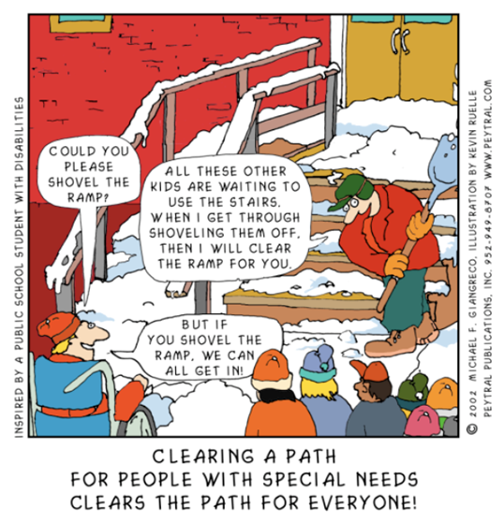
Universal Design for Learning (UDL)
Notes:
Universal Design for Learning stems from the architectural principles of universal design, such as sidewalk cuts and ramps vs. stairs. What is a necessity for some is good for all.

Slide 7
UDL in Collaborative Therapy
Applying UDL within a classroom or for a caseload of students starts with three initial steps:
assess diverse learner needs,
define appropriate goals that allow for multiple means of attainment, and
evaluate barriers that may exist within the current curriculum.

Slide 8
Evaluating Curriculum Barriers
Most curricula are designed as if all students learn in the same way. In reality, the idea of a “typical” learner is a myth.
Barriers to learning may not be present within students but rather in the intersection of students and the curriculum and/or environment.
Educators can move beyond identifying individual learning difficulties to focusing on and addressing the barriers that exist within the curriculum and/or environment.

Slide 9
Use of Universal Design in Therapy
Example:
Physical therapists look at the student’s skills and barriers to performance, the environment and context, and the learning task itself, then make appropriate modifications or provide supports to facilitate learning.

Slide 10
Assessing Diverse Learner Needs
Who are these students?
How do they learn best?
What strengths, cultural backgrounds, learning styles, and interests do they bring to the learning situation?
What forms of communication do they use?
How do they execute a plan for learning?
What are their talents?

Slide 11
Defining Appropriate Goals
Standardized goals sometimes include the means for achieving the standard within the goal itself. For example, a goal that requires all students to “Print with appropriate spacing between words and sentences” has only one rigid expected outcome because the means for demonstrating achievement of the standard is embedded in the goal and restricted to one medium of expression.

Slide 12
Defining Appropriate Goals
Conversely, a goal that requires all students to “Write informative/explanatory texts in which they name a topic, supply some facts about the topic, and provide some sense of closure” (W.1.2) allows students flexibility in how they will meet this expectation.

Slide 13
Related Service Guidelines

Slide 14
Therapy as Educational Support Services
Formerly: | Currently:
Focus on Disabilities and Problems | Focus on Student Outcomes and Abilities
Pullout Isolated Service | Support to Student from All Student Personnel
Families Given Information, Little Involvement | Families Team with School Personnel as Partners
Students Segregated from Other Students | Students Included with Other Students
Therapy-Specific Student Goals | Curriculum-Based Educational Student Goals
Therapist Provides Service Independently | Many Types of School Personnel Involved
Standardized Tests Used | Also Observe and Assess Student Level of Functioning
Clinic-Based Assistance | School- and Community-Based Assistance

Slide 15
Every Student Succeeds Act (ESSA)
Under ESSA, related service providers are known as Specialized Instructional Support Personnel (SISP).
This title was specially chosen to signify that these professionals possess specialized skills that enhance quality instruction to help students be successful in school.

Slide 16
Specialized Instructional Support Personnel (SISP)
Perform a wide range of activities in schools, including a broad array of prevention and intervention services that promote effective teaching and learning and promote school success
Collaborate with teachers and school staff to ensure that students receive high quality instruction responsive to their diverse academic, physical, social, emotional, and mental health needs

Slide 17
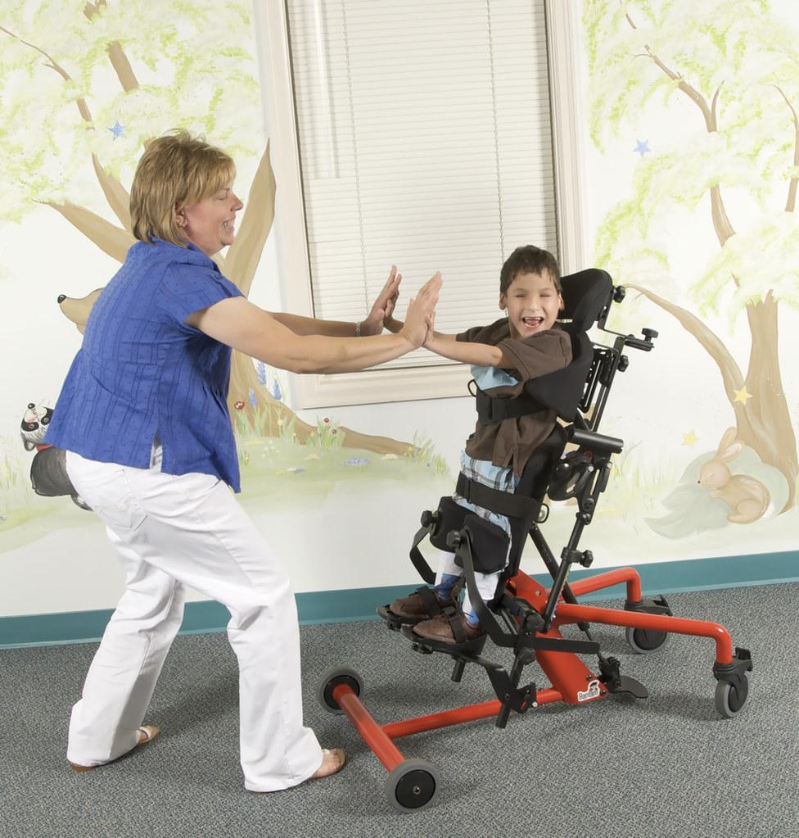
ESSA and Related Service Providers
SISP include, but are not limited to:
School nurses
Speech-language pathologists
Audiologists
Occupational therapists
Physical therapists
Counselors

Slide 18
Special Education and Related Services under IDEA
The Individuals with Disabilities Education Act (IDEA) defines related service as services that are provided to the child, or on behalf of the child:
(i) To advance appropriately toward attaining the annual goals;
(ii) To be involved in and make progress in the general education curriculum in accordance with paragraph (a)(1) of this section, and to participate in extracurricular and other non-academic activities; and
(iii) To be educated and participate with other children with disabilities and nondisabled children in the activities described in this section. [§ 300.320(a)(4)]

Slide 19

Eligibility Criteria for Services under IDEA
IDEA’s definition of related services should guide how a child’s IEP team considers what related services the child needs and the detail with which the team specifies them in the IEP.
The local education agency (LEA) is not required to provide a service to a child just because he/she will benefit from the service.
The key factor in determining whether the service is necessary and whether it enables the child to benefit from educational instruction.

Slide 20
Educational Impact of a Disability
Adverse educational impact is evident when a student’s disability negatively impacts his/her:
Involvement and advancement in the general education program (academic impact);
Education and participation with other students without disabilities (social/behavioral impact);
Participation in extracurricular and other non-academic activities (vocational impact).

Slide 21
Adverse Educational Impact of Physical Deficits
Inability to move safely around the school
Fatigue caused by low muscle tone
Poor handwriting
Limited or no access to activities with peers

Slide 22
Adverse Educational Impact of Occupational Deficits
Difficulty copying from the board
Poor organizational skills
Dependency on others for self-care skills (dressing, toileting, feeding, etc.)
Anxiety
Poor grades

Slide 23
Adverse Educational Impact of Speech/Language Deficits
Inability to communicate with peers and teachers
Difficulty processing written and oral language
Difficulty following directions
Inability to express functional wants and needs

Slide 24
Diagnosis vs. Eligibility
Generally, a diagnosis from a health care professional using criteria from the Diagnostic and Statistical Manual of Mental Disorders (DSM) and/or International Statistical Classification of Diseases and Related Health Problems (ICD-10 Codes) is not required to determine special education eligibility, nor is such diagnosis alone sufficient to determine eligibility for special education.

Slide 25

Diagnosis vs. Eligibility
When diagnostic or prescriptive information from a health care professional is available to the public agency, the team must consider the information when making an eligibility determination for special education.

Slide 26
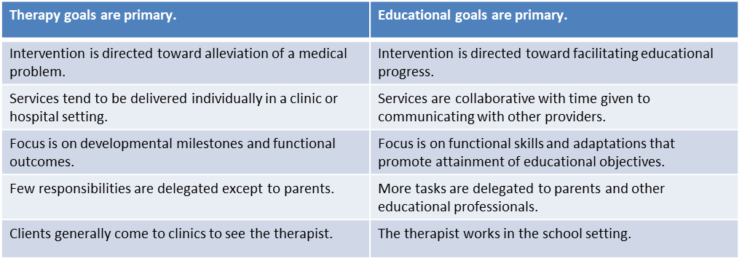
Determining the Need for Related Services

Slide 27
Continuum of Service Delivery Options
The IEP Committee should consider the level of expertise needed to address educational goals. Consider the following questions:
Can the goals be addressed with adaptations and modifications to the classroom environment or curriculum?
Can the goals be addressed by classroom instructional staff using typical educational strategies with a reasonable expectation of success?

Slide 28
Continuum of Service Delivery Options
Can the goals be addressed with consultation and guidance from the therapist?
Can the classroom instructional staff conduct activities designed by the therapist with a reasonable expectation of success?
Can activities designed to address educational goals be delivered to the student only by a licensed professional therapist?

Slide 29
Who Provides the Services?
The IEP Committee determines the needs of the student based on assessment data.
The committee then determines who will provide the service.
The committee should consider all strategies and resources available including, but not limited to, a related service.

Slide 30
Who Provides the Services?
Even when a student is disabled and needs specifically designed instruction, the child does not automatically receive related services.
The services become part of the student’s IEP when the IEP Committee determines they are needed for the student to benefit from special education and the needs are so severe that they cannot be served by his/her teacher(s).

Slide 31
Do You Need a Prescription?
Effective July 1, 2006 Physical Therapists must have a referral except in the following instances:
A physical therapist licensed under the physical therapy law shall not perform physical therapy services without a prescription or referral from a person licensed as a physician, dentist, osteopath, podiatrist, chiropractor or nurse practitioner. However, a physical therapist may perform physical therapy services without a prescription or referral under the following circumstances:
1. To children with a diagnosed developmental disability pursuant to the patient's plan of care.
Notes:
According to the MS PT Board response to my question in September 2019, children with IEPs fall under #1 and do not require a prescription for services. The Board also considers the IEP to be the plan of care for students receiving services under IDEA.

Slide 32
School-Based PT

Slide 33
School-Based Physical Therapy
Physical therapists perform therapeutic interventions, including compensation, remediation, prevention strategies and adaptions which focus on functional mobility.
The goal of physical therapy is for students to increase participation in natural learning environments with safe, efficient access and optimal participation in activities and routines.
School-based physical therapists collaborate with other specialized instructional support personnel and school community members to build student achievement in all domains that affect academic success and wellness.

Slide 34
Characteristics of a Physical Disability
Difficulty with:
Postural strength and control
Functional mobility (e.g., walking and running)
Body and safety awareness
Coordination
Play skills
Ability to change between different activities
Strengths and challenges in making large body movements, such as jumping, pedaling a tricycle or bicycle, and skipping
Participation in daily routines in the home, community, and school

Slide 35
What PT Looks Like in Schools
Gathering information regarding the child’s functional motor performance in school settings
Selecting, administering and interpreting a variety of screening instruments and standardized measurement tools
Examining and evaluating eligible students’ strengths and needs to establish their ability to participate in meaningful school activities and routines with or without assistance
Participating in team meetings, including parent conferences
Participating in the IEP process, including collaboratively determining the need for physical therapy as a related service (IDEA)
Forming partnerships and working with other team members in the school setting to promote an effective physical therapy plan of care

Slide 36
What PT Looks Like in Schools
Coordinating physical therapy interventions within the school program
Adapting environments to facilitate student access and participation in the educational program
Functioning as a consultant to other school personnel, parents, and students to coordinate the delivery of physical therapy services, which may include:
  interpretation of assessments and recommendation
  explanation of the potential impact of developmental, medical and/or sensorimotor problems on school performance
  instruction of other caregivers in the physical management of students, such as safe lifting, positioning, assisted ambulation, gross motor programs, vocational tasks, leisure activities, and/or equipment use
  setting realistic expectations for student performance in school and
  selecting, modifying, or customizing adaptive equipment and assistive technology

Slide 37
What PT Looks Like in Schools
Educating school personnel and families to promote inclusion of students within the educational experience by developing, demonstrating, training and monitoring the effectiveness of strategies and intervention activities.
Using data to make decisions, including the use of assistive technology for access and participation in the general education curriculum.
Supporting the safe transportation of students.
Referring students to other related service personnel and to healthcare providers as appropriate.
Serving as a liaison among school, medical personnel, and medical equipment vendors.

Slide 38

IEP Meeting Participation
What does Federal guidance say about including SISP in IEP meetings?
Notes:
You must be invited to participate and give input in writing if you are not able to attend.

Slide 39
Case Study
Joey, a six-year-old first grade student, has an OHI ruling due to a diagnosis of right sided hemiplegia, a condition that affects his ability to move freely without the assistance of a walker. Joey spends most of his day in a general education class with his first-grade peers. A PT evaluation revealed decreased muscle tone throughout all muscle groups. He exhibited decreased strength as demonstrated by his inability to sustain antigravity positions. He demonstrates decreased balance as he has difficulty ambulating over uneven surfaces and does so slowly to compensate. He demonstrates only momentary single limb balance. He is unable to negotiate stairs, jump, or get access to age-appropriate play structures without assistance. Joey’s gross motor delays hinder his ability to gain access to the playground safely and independently in order to participate with his peers in age-appropriate activities. The teacher is concerned that he cannot negotiate stairs on the playground nor maintain balance when sitting and reaching.

Slide 40

Share Your Thoughts
What deficit skills would you address with an annual goal?
What classroom accommodations would be most helpful for Joey?
Who could best support him in achieving his goals?
Notes:
Type your answers in the chat box.

Slide 41
Present Levels of Academic Performance and Functional Performance (PLAAFP)
Student’s strengths, preferences and interests identify the child’s educational and/or developmental strengths, interest areas, significant personal attributes and personal accomplishments as indicated by formal or informal assessment.
Student Needs and Impact of the Disability identifies the child’s educational deficit skills and how that impacts his/her ability to access the general education curriculum.
Parent/Student Input gives parents and students (if old enough to participate) the ability to share thoughts on what they know, expect and hope for the school year.

Slide 42
Establishing a Baseline
The baseline should include:
a data source,
a clear description of the observable target skill or behavior,
the condition under which the target skill can be observed, and
the current rate of performance.

Slide 43
Baseline Examples
Based on assessment data, when given a visual model, Joey is currently able to balance on one foot for <3 seconds.
According to documentation from previous therapy sessions, Joey is able to ascend and descend 4 steps on 4/10 attempts with at 8 or fewer verbal cues.
According to teacher observation, Joey is currently able to independently keep his balance in a sitting position for no more than 4 minutes.

Slide 44
Writing Educational Standards-Based Goals
Measurable annual goals are academic and/or functional goals that are written to meet the child’s needs that result from the child’s disability to enable the child to be involved in and progress in the general education curriculum and meet each of the child’s other educational needs that result from the child’s disability (C.F.R. § 300.320(a)(2)).
•They must be meaningful, understandable, and able to be accomplished within one school year.

Slide 45
Writing Educational Standards-Based Goals
Annual goals should focus on functional and academic needs identified in the PLAAFP.
Annual goals are statements that identify the knowledge, skills, and/or behaviors a student is expected to demonstrate within a specified time period.
Annual goals should be written in easily understood language.
Annual goals belong to the child, not the service provider.

Slide 46
Components of a Standards-Based Goal
Timeframe - what is the target date for achieving the goal?
Condition - what is the instructor providing?
Behavior - what is the student expected to do?
Criteria - how well must the student perform to meet the goal?

Slide 47
Connecting the Baselines and Annual Goals
PLAAFP
Joey has difficulty negotiating stairs and maintaining his balance.
Baseline
Joey is able to ascend and descend 4 steps in an alternating pattern on 4/10 attempts with 8 or less verbal cues.
Annual Goal
By May 25, 2021, Joey will be able to ascend and descend 4 steps in an alternating pattern on 8/10 attempts with 4 or less verbal cues.

Slide 48
Example: Annual Goals
Timeframe | Condition | Behavior | Criteria
By May 25, 2021, | With 4 or fewer verbal prompts | Joey will be able to ascend and descend 4 steps | 8/10 attempts
By the end of the 4th 9 weeks, | When given a visual model | Joey will balance on one foot | For at least 10 seconds
By the end of the 20-21 school year, | Independently | Joey will demonstrate increased core muscle strength by | sitting upright for at least 10 minutes

Slide 49
Dismissal Criteria

Slide 50
Dismissal Criteria
Students should be dismissed from language/speech therapy and other related services when one of the following criteria is met:
they no longer have a disability; and/or
they no longer require related services due to their disability.

Slide 51
Dismissal Criteria
The IEP Committee determines that services are no longer warranted due to:
The student no longer meets eligibility criteria for services when:
  He/she has mastered IEP goals/objectives.
  Skills are within normal limits.

Slide 52
Dismissal Criteria
The student’s progress has plateaued and/or the student no longer benefits from services.
  IEP shows lack of progress, and reevaluation data supports this.
  Lack of progress is due to:
    Limited ability to self-monitor communication
    Poor attendance
    Lack of motivation
    Limited potential for significant change.

Slide 53
Dismissal Criteria
  Affected skills no longer have an adverse impact on academic, social/behavioral, or vocational performance.
  The student no longer requires services due to their disability.
    Skills can be monitored and maintained in the student’s environment.
    Skills are being addressed by others in the student’s environment (i.e., special education teacher, general education teacher, parent, etc.).

Slide 54
The Collaborative Approach

Slide 55
Keys to Collaboration
Develop classroom environments that integrate same-aged peers with and without disabilities.
Make teachers aware of students’ individual physical needs.
Work with other therapists and classroom staff to ensure meaningful opportunities throughout the school day for fine motor and/or gross motor/functional mobility skills.
Include all students in programs and activities within the school environment.

Slide 56
10 Golden Rules of Collaboration
Find common ground.
Treat each other with complete respect.
Don’t pose as an expert.
Ask questions.
Build on strengths.

Slide 57
10 Golden Rules of Collaboration
Do what you say you are going to do.
Maintain confidentiality.
Listen - really listen.
Value relationships over efficiency.
Provide positive feedback.

Slide 58


Slide 59
Universal Design for Learning Resources
CAST – free UDL tools http://www.cast.org/our-work/learning-tools.html#.V_ZuylQdBPZ
Curriculum Barrier Finder https://sites.google.com/site/udlcanisius/cast-learning-tools/curriculum-barriers-finder
The Myth of Average video https://www.youtube.com/watch?v=4eBmyttcfU4

Slide 60
Resources
State Practice Acts and IDEA fact sheet
American Speech-Language-Hearing Association - www.asha.org
American Occupational Therapy Association - www.aota.org
American Physical Therapy Association - www.apta.org

Slide 61
Teresa Laney, M.S., CCC-SLP
Tracie Thornton, PT, DPT, MPH
MDE Office of Special Education
tlaney@mdek12.org
Pediatric Physical Therapist
School Districts/Early Intervention
tthornton@prcc.edu

