Slide 1
Anterior Cruciate Ligament Injury:
A Discussion On Injury Mechanisms, Current Rehabilitation, And Future Directions For Physical Therapy
Dr. Shelby Peel

Slide 2
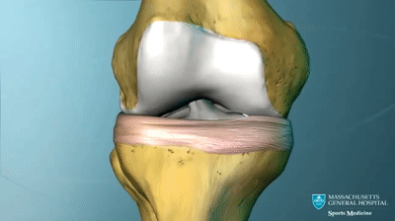
ACL Anatomy
Attachment points
  Femur: medial wall of lateral femoral condyle
  Tibia: anterior aspect of the medial intercondylar tibial spine
Width:
  7 – 12 mm
  mean width: 11 mm
Length:
  22 – 41 mm
  mean length: 32 mm
Notes:
Length and Width of ACL both smaller in females

Slide 3
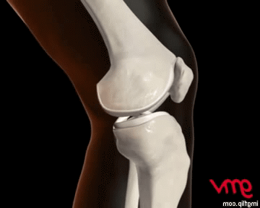
ACL Function
Primary
  RESIST anterior tibial translation
Notes:
ACL resisted 82 – 90% of all anterior tibial translation from 0 – 90 deg knee flexion

Slide 4
ACL Function
Primary
  RESIST anterior tibial translation
0 – 90° knee flexion: resists 82 – 90% of all anterior tibial translation
Notes:
ACL resisted 82 – 90% of all anterior tibial translation from 0 – 90 deg knee flexion

Slide 5
ACL Function
Primary
  RESIST anterior tibial translation
Secondary
  RESIST tibial internal rotation
Notes:
ACL resisted 82 – 90% of all anterior tibial translation from 0 – 90 deg knee flexion

Slide 6
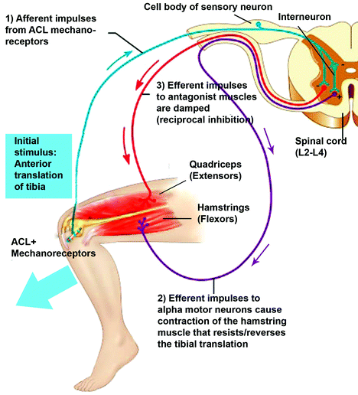
ACL Function
Important component of knee stability and proprioception
  Contains mechanoreceptors
    Ruffini endings
    Pacinian corpuscles
    Golgi tendon organs
Notes:
Pacinian corpuscles are sensitive to rapid changes in accelerations
Ruffini endings and Golgi tendon organs provide the central nervous system with information regarding knee joint position

Slide 7
ACL Function
Important component of knee stability and proprioception
  Contains mechanoreceptors
    Ruffini endings
    Pacinian corpuscles
    Golgi tendon organs
Relay information regarding anterior tibial translation to the central nervous system
Notes:
mechanoreceptors become excited and send afferent impulses to the central nervous system. Consequentially, muscles surrounding the knee joint will contract to regulate dynamic stability and muscular stiffness in an effort to prevent ligament injury
directly stressing the ACL, quadriceps muscle activity moderately decreased, but hamstring muscle activity increased in order to stabilize and protect the ACL.
damage to the mechanoreceptors within the ACL would alter or inhibit the protective mechanisms of the surrounding musculature, leading to detriments in overall stability and functionality of the knee joint.

Slide 8
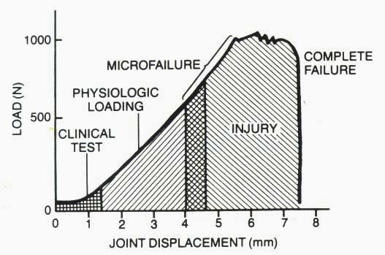
ACL Injury Mechanisms
Occurs when load on the ACL has surpassed the threshold of load the ACL can withstand
  Mean maximal load for 22 – 35 yrs:
    2160 ± 157 N (~485 ± 35lbs/force)

Slide 9
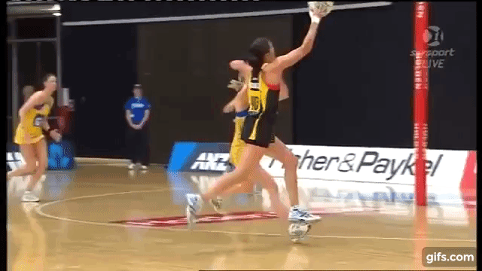
Acl injury
Approximately 250,000 injuries occur in the USA every year
Rate of ACL injuries continues to increase
  32.9 per 100,000 person/year (1994)
  43.5 per 100,000 person/years (2006)
70% of all ACL injuries are considered “noncontact”
Notes:
TRANSITION: Because noncontact ACL injuries are extremely common, specific risk factors have been identified to be associated with an athlete who may be at a higher risk of injury than another athlete
One of the most common knee injuries sustained by active individuals

Slide 10
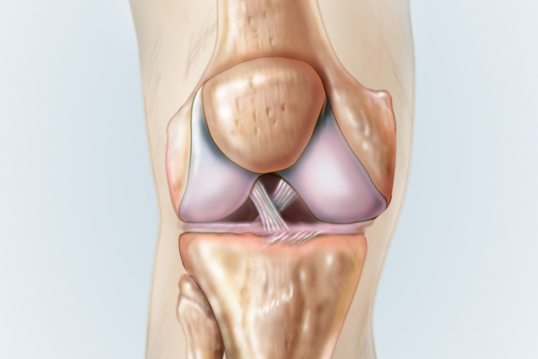
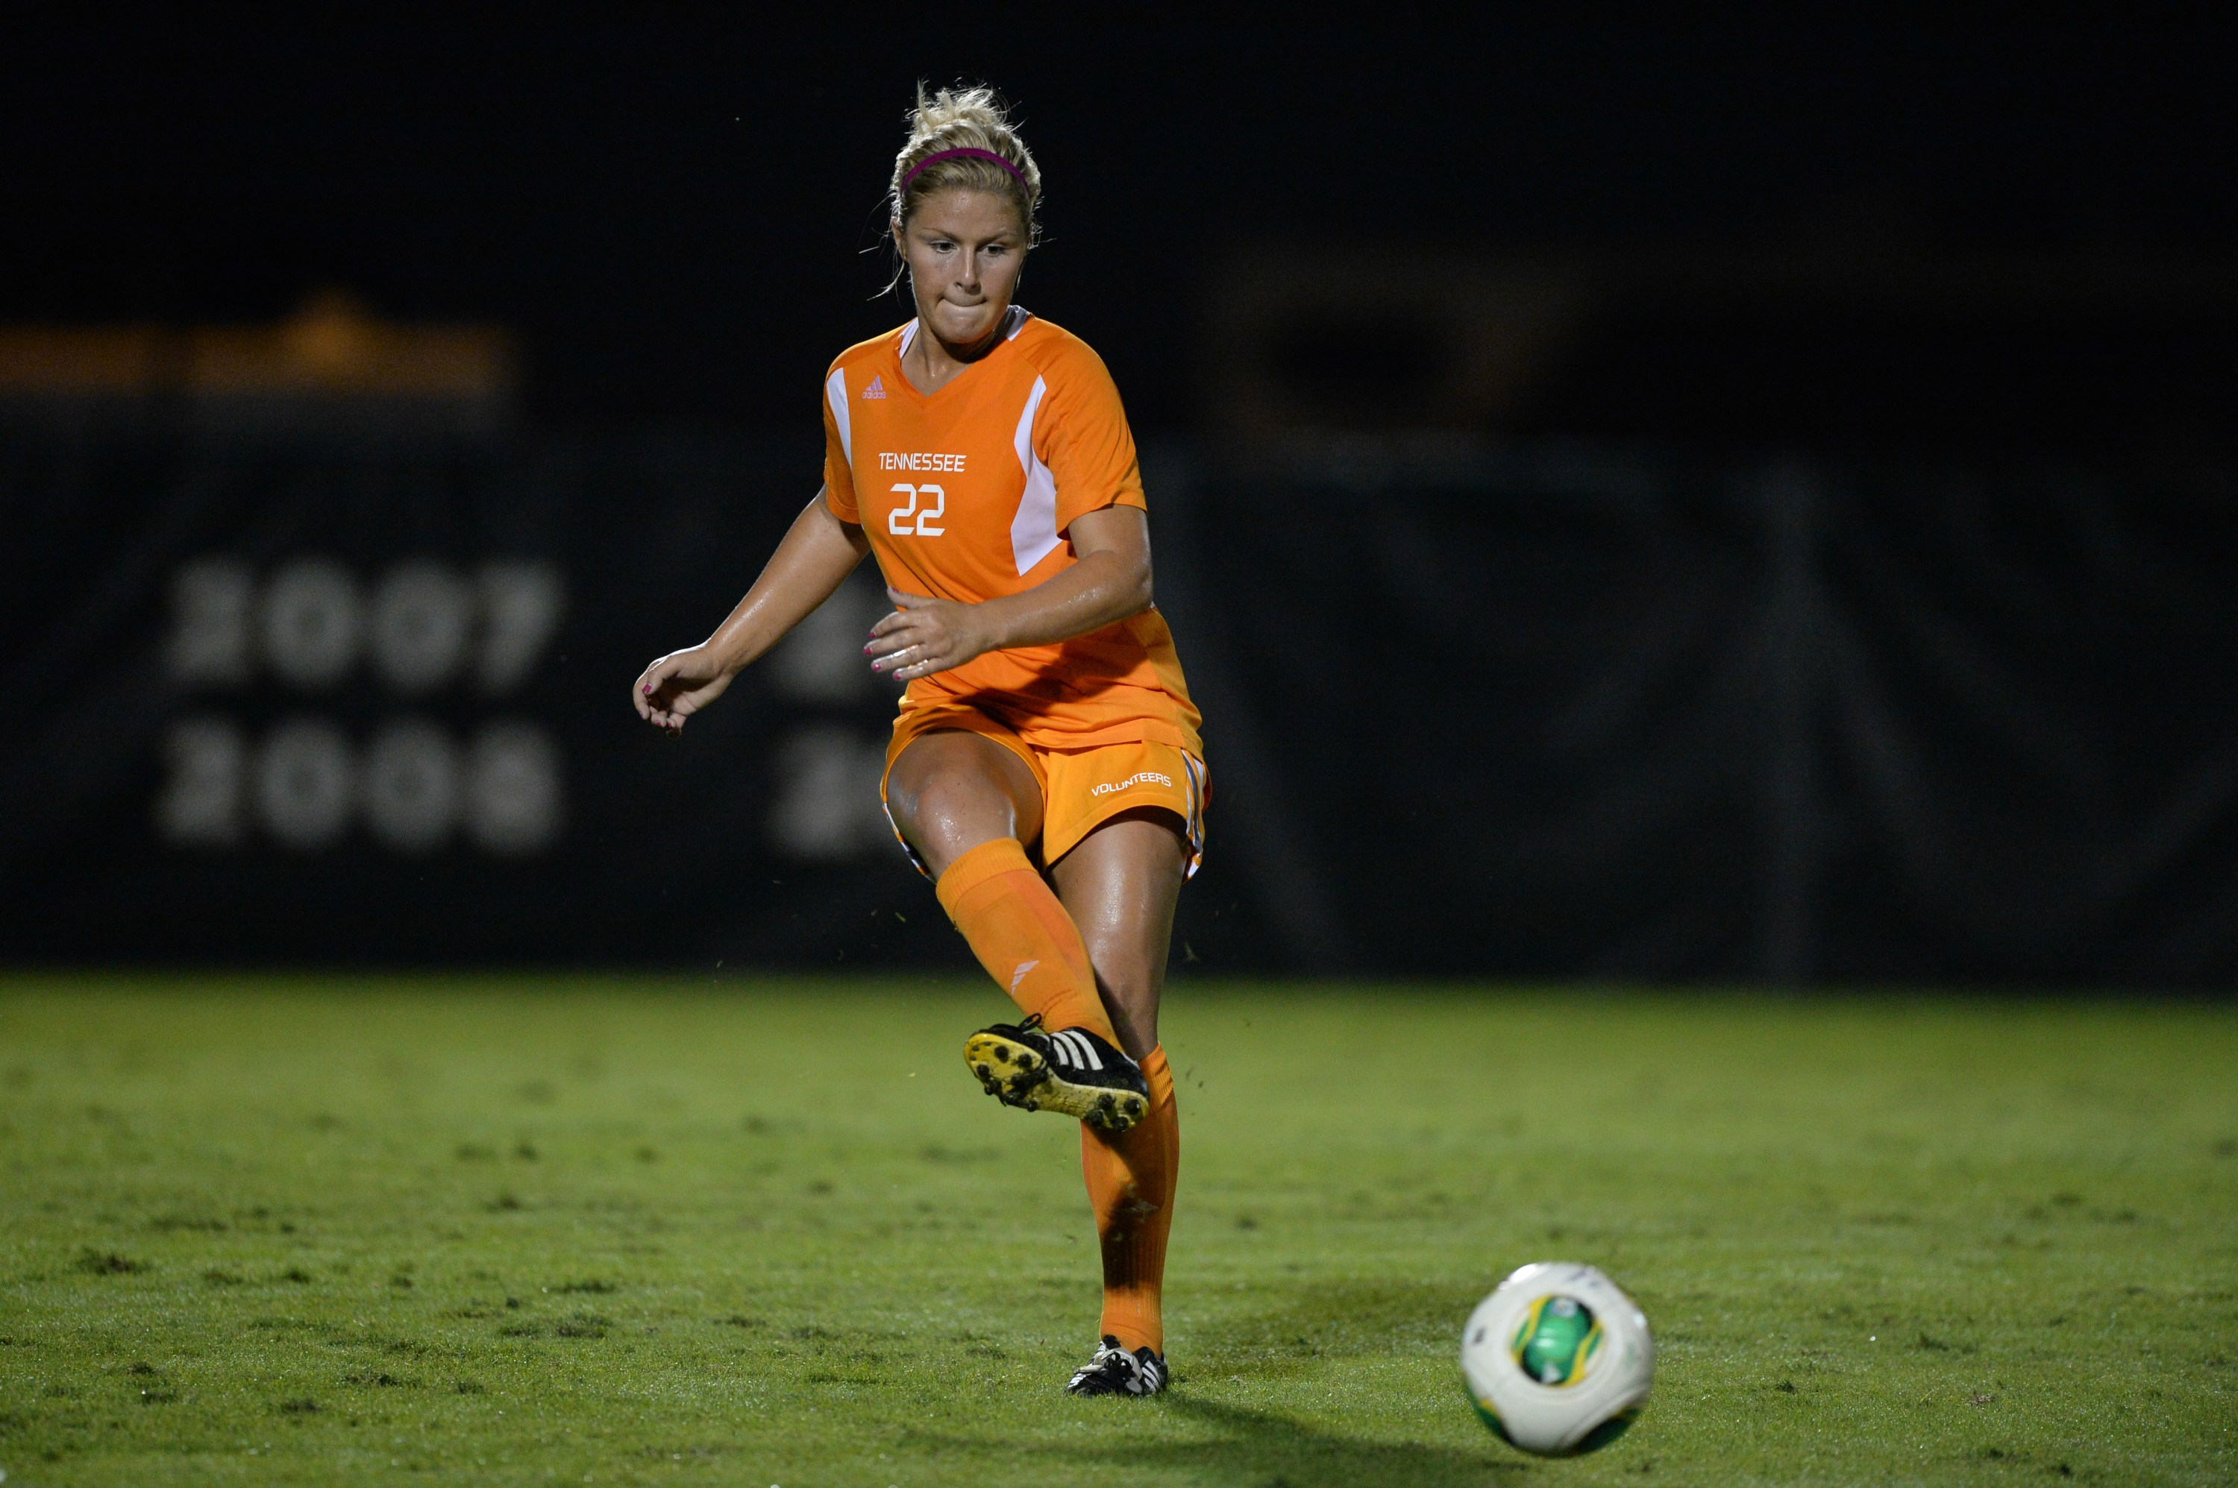
Acl injury Risk Factors
  Anatomical variables
  Age
  Gender
  Prior ACL injury
  Fatigue
  Playing surface
  Footwear
  Environmental conditions
  Type of task
Internal
External

Slide 11
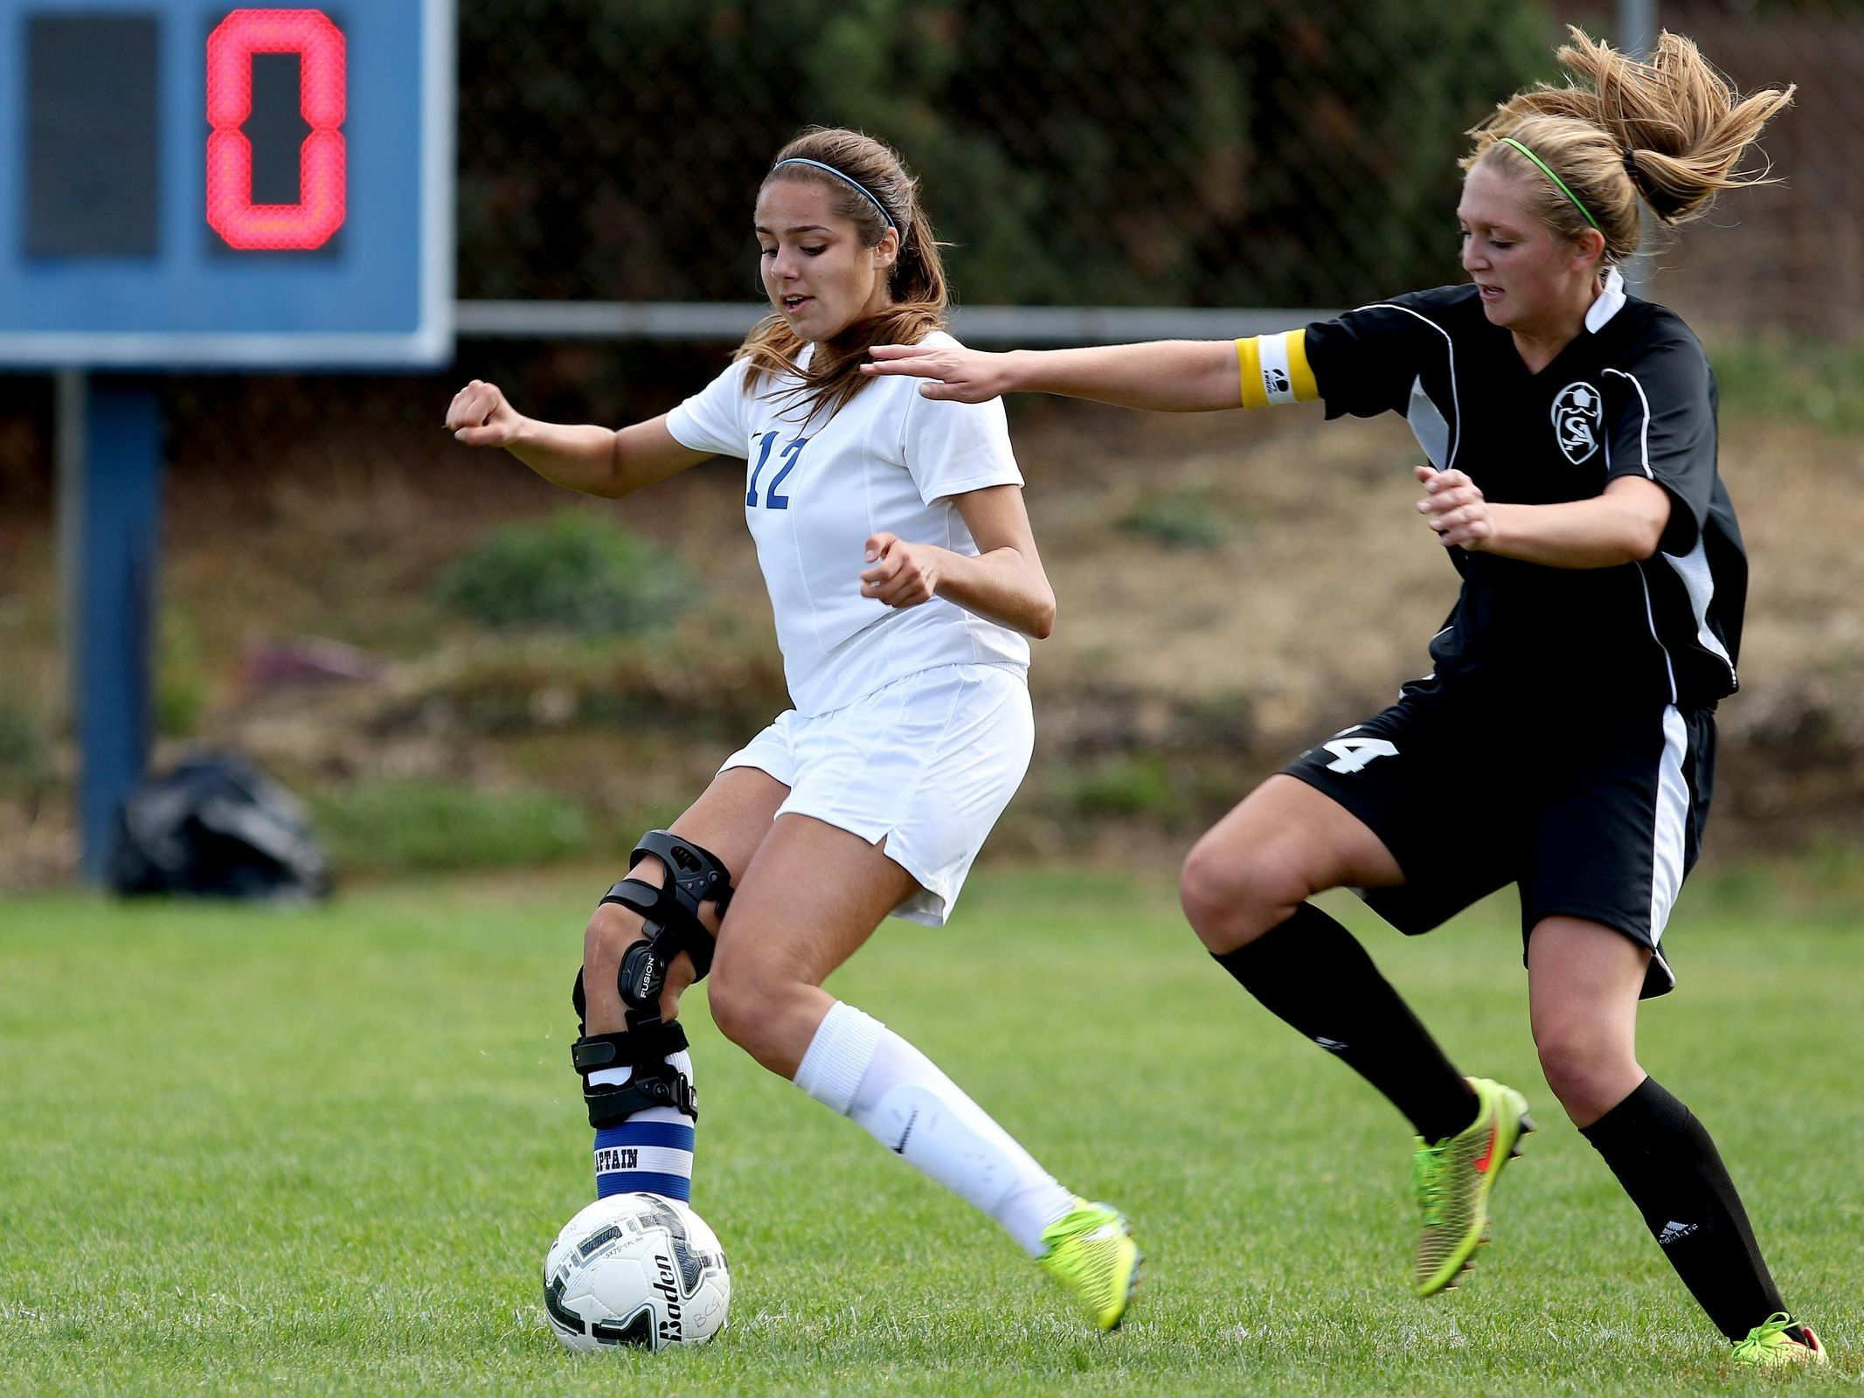
Acl injury Risk Factors
1. Gender
  Females: 2 – 8x more likely to sustain an ACL injury compared to male counterparts
Notes:
both anatomical factors, such as females having larger Q-angles, smaller ACL length and circumference, and increased hormonal fluctuations throughout the month, and biomechanical factors like landing with a more erect posture or cutting with larger knee abduction angles
Hormones: hypothesized to influence ACL injury by exerting a direct effect of ligament laxity or stiffness through collagen synthesis and tensile properties given estrogen, progesterone, testosterone, and relaxin receptors on the ACL or through neuromuscular changes affecting knee alignment.

Slide 12
Acl injury Risk Factors
1. Gender
  Females: 2 – 8x more likely to sustain an ACL injury compared to male counterparts
  Due to anatomical, hormonal, and neuromuscular factors
Notes:
both anatomical factors, such as females having larger Q-angles, smaller ACL length and circumference, and increased hormonal fluctuations throughout the month, and biomechanical factors like landing with a more erect posture or cutting with larger knee abduction angles
Hormones: hypothesized to influence ACL injury by exerting a direct effect of ligament laxity or stiffness through collagen synthesis and tensile properties given estrogen, progesterone, testosterone, and relaxin receptors on the ACL or through neuromuscular changes affecting knee alignment.

Slide 13
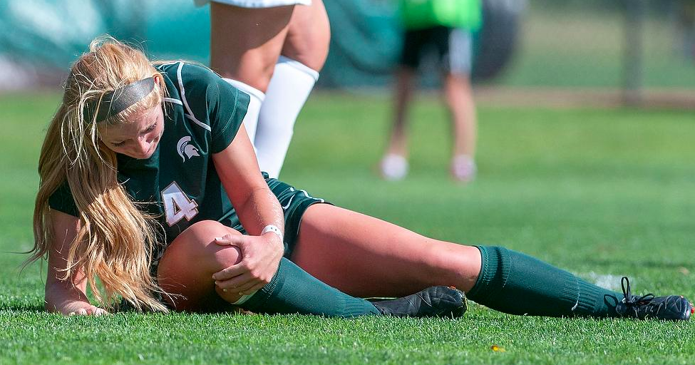
Acl injury Risk Factors
2. Prior ACL Injury History
  83% of all athletes who undergo an ACL-reconstruction (ACL-R) return to their pre-injury sport

Slide 14
Acl injury Risk Factors
2. Prior ACL Injury History
  83% of all athletes who undergo an ACL-reconstruction (ACL-R) return to their pre-injury sport
  10 – 30% who do return to sport after ACL-R will sustain a 2nd ACL injury

Slide 15
Acl injury Risk Factors
2. Prior ACL Injury History
  83% of all athletes who undergo an ACL-reconstruction (ACL-R) return to their pre-injury sport
  10 – 30% who do return to sport after ACL-R will sustain a 2nd ACL injury
  Females are 16 x more likely to sustain a 2nd ACL injury after ACL-R compared to healthy females

Slide 16
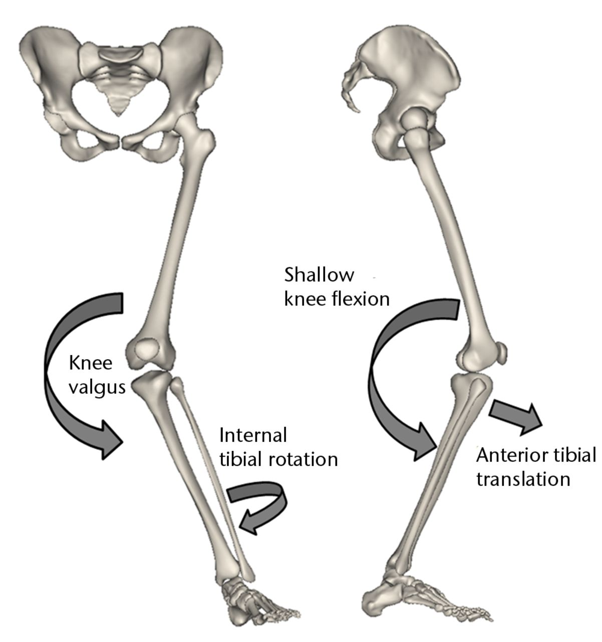
Acl injury Risk Factors
3. Type of Movement Task
  Quick decelerating
  Single leg tasks
  Cutting tasks
KAM

Slide 17
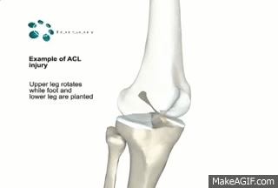
ACL Injury Mechanisms
McLean (2004) demonstrated that sagittal plane loading (i.e., purely anterior tibial translation) is often NOT enough to rupture the ACL
  2160 ± 157 N (~485 ± 35lbs/force)
ACL ruptures are most often multi-planar in nature

Slide 18
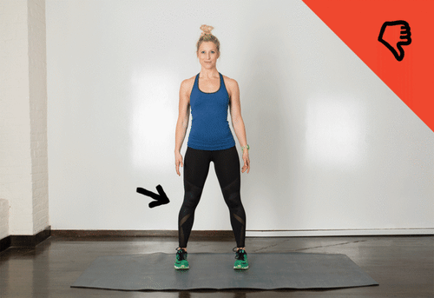
ACL Injury Mechanisms
Most common position associated with ACL injuries:
  medial knee collapse

Slide 19
ACL Injury Mechanisms
Most common position associated with ACL injuries:
  medial knee collapse
Increased:
  Hip internal rotation angle
  Knee abduction; internal/external rotation angle
  Knee adduction moment
Decreased:
  Knee flexion angle

Slide 20
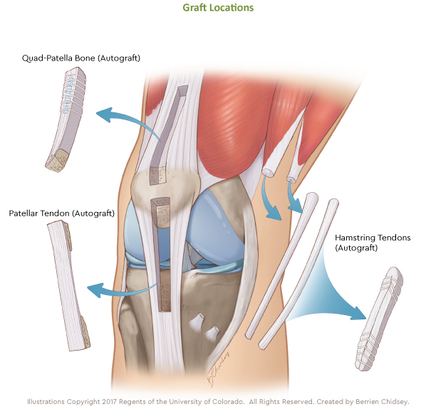
ACL Reconstruction
100,000 to 150,000 of all ACL injuries will undergo an ACL-reconstruction
$2 billion annually for the cost of ACL-R subsequent physical therapy
Rate of ACL reconstructions increased 22% from 2002 to 2014

Slide 21
ACL Reconstruction
Primary goal:
  Return individuals back to active lifestyle by regaining knee stability
Secondary goal:
  Decrease risk of developing knee osteoarthritis
    ~50% of individuals with an ACL injury with develop knee osteoarthritis 10-15 years after injury

Slide 22
ACL Reconstruction
Mechanical alterations exist after ACL-R
  Altered knee joint kinematics and kinetics
  Decreased muscular strength
  Altered muscular activity
  Loss of proprioception
  Changes in coordinative variability
Notes:
Altered lower extremity mechanics shown to exist 7 years plus post ACL-R

Slide 23
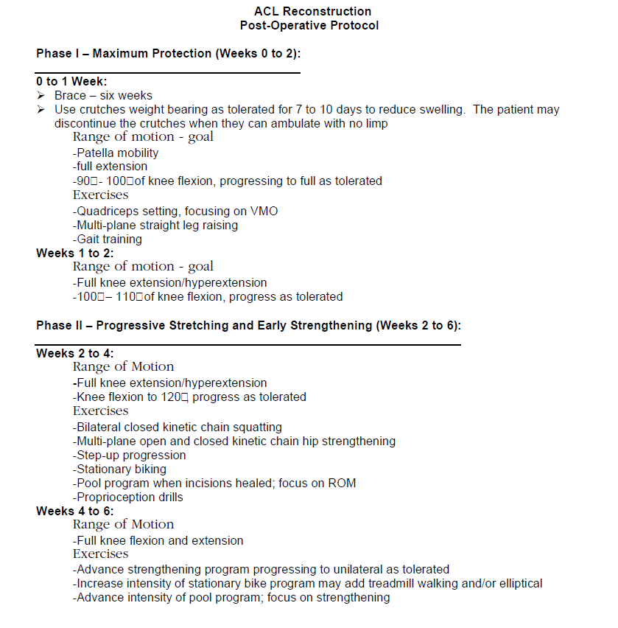
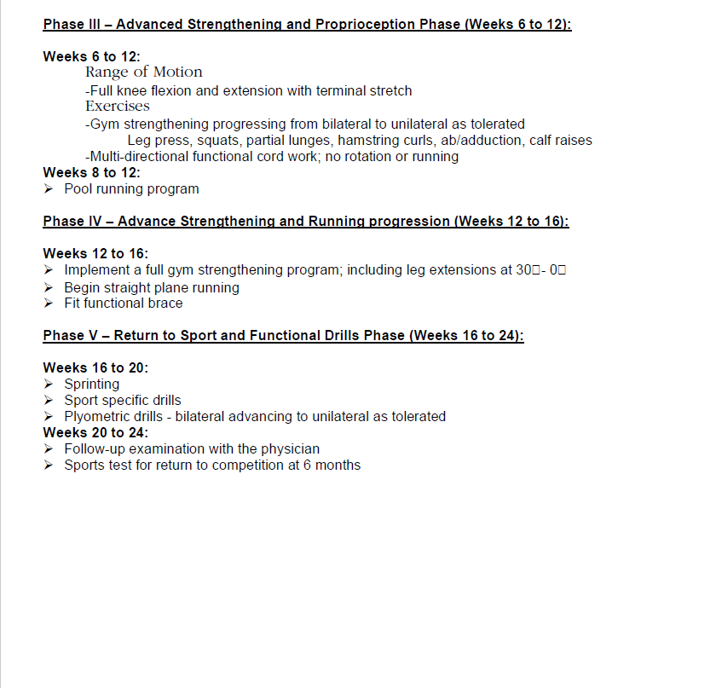
Current ACL Rehabilitation

Slide 24
Current ACL Rehabilitation
Most ACL-R post-operative protocols contain the same overall progression plan, and are generally accepted by the rehabilitation community
  Protection of the reconstruction
  Progressive stretching/early strengthening
  Advance strengthening/proprioception
  Functional return to sport drills

Slide 25
Current ACL Rehabilitation
Most ACL-R post-operative protocols contain the same overall progression plan, and are generally accepted by the rehabilitation community
Shift in focus from accelerated protocols to longer duration protocols (i.e., 9 – 12 months)
  Due to enhanced focus on return to sport and limb function

Slide 26
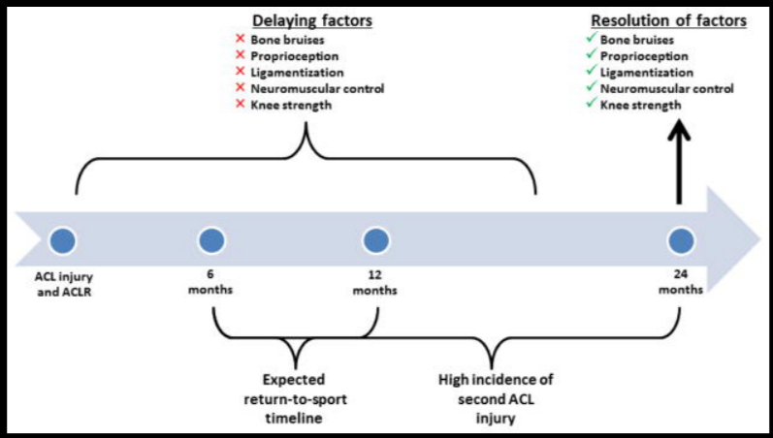
Return to Sport… When is good?
Typical timeline of return to sport for ACL-R individuals
  Depends
  4 - 6 months seems to be the generic return to sport timeline
Notes:
Strong evidence now indicates that younger, more active athletes are at particularly high risk for a second ACL injury, and this risk is greatest within the first 2 years following ACLR. Nearly one-third of the younger cohort that resumes sports participation will sustain a second ACL injury within the first 2 years after ACLR. The evidence indicates that the risk of second injury may abate over this time period. The incidence rate of second injuries in the first year after ACLR is significantly greater than the rate in the second year. T

Slide 27
Return to Sport… When is good?
Typical timeline of return to sport for ACL-R individuals
  Depends
  4 - 6 months seems to be the generic return to sport timeline
Beischer (2020)
  Surveyed 159 athletes with primary ACL-R
  Found athletes that returned to sport earlier than 9 months post-ACL-R were 7 times higher to sustain a second ACL injury
Notes:
Strong evidence now indicates that younger, more active athletes are at particularly high risk for a second ACL injury, and this risk is greatest within the first 2 years following ACLR. Nearly one-third of the younger cohort that resumes sports participation will sustain a second ACL injury within the first 2 years after ACLR. The evidence indicates that the risk of second injury may abate over this time period. The incidence rate of second injuries in the first year after ACLR is significantly greater than the rate in the second year. T

Slide 28
Return to Sport… When is good?
Typical timeline of return to sport for ACL-R individuals
  Depends
  4 - 6 months seems to be the generic return to sport timeline
Beischer (2020)
  Surveyed 159 athletes with primary ACL-R
  Found athletes that returned to sport earlier than 9 months post-ACL-R were 7 times higher to sustain a second ACL injury
Hewett (2017) suggests some athletes may take up to 2 years to return back to sport
Notes:
Strong evidence now indicates that younger, more active athletes are at particularly high risk for a second ACL injury, and this risk is greatest within the first 2 years following ACLR. Nearly one-third of the younger cohort that resumes sports participation will sustain a second ACL injury within the first 2 years after ACLR. The evidence indicates that the risk of second injury may abate over this time period. The incidence rate of second injuries in the first year after ACLR is significantly greater than the rate in the second year. T

Slide 29
Return to Sport… When is good?
Return to Sport Tests
Isokinetic strength testing
6-m Timed Hop Test
Single Hop Test
Triple Hop Test
Triple Crossover Test
Ham:Quad strength ratio
General consensus… no agreeance
No clear cut set of criterion tests used
How do you determine return to sport?

Slide 30
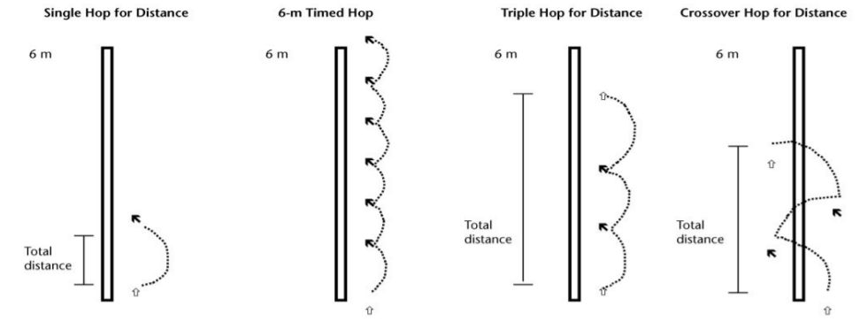
Return to Sport… When is good?
Single leg hop tests
  Start at 6 months post-operation
Current return to sport criteria:
  90% limb symmetry between healthy and reconstructed limb (distance and/or time) for all four single-leg hop tests

Slide 31
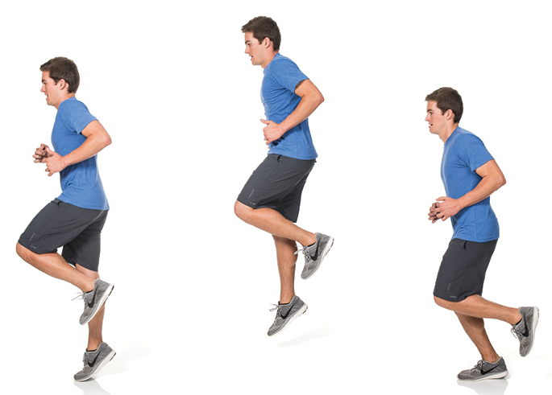
Return to Sport… When is good?
Single-leg vertical hop?
Taylor (2020)
  Tested the single-leg horizontal hop vs the single-leg vertical hop
  Single-leg vertical hop displayed
    Differences in lower peak ankle dorsiflexion and knee abduction angles
    Lower sagittal plane impulse at the knee
    Greater sagittal plane impulse at the hip

Slide 32
Return to Sport… When is good?
Single-leg vertical hop?
Could potentially provide complementary information to standard horizontal hopping tests

Slide 33
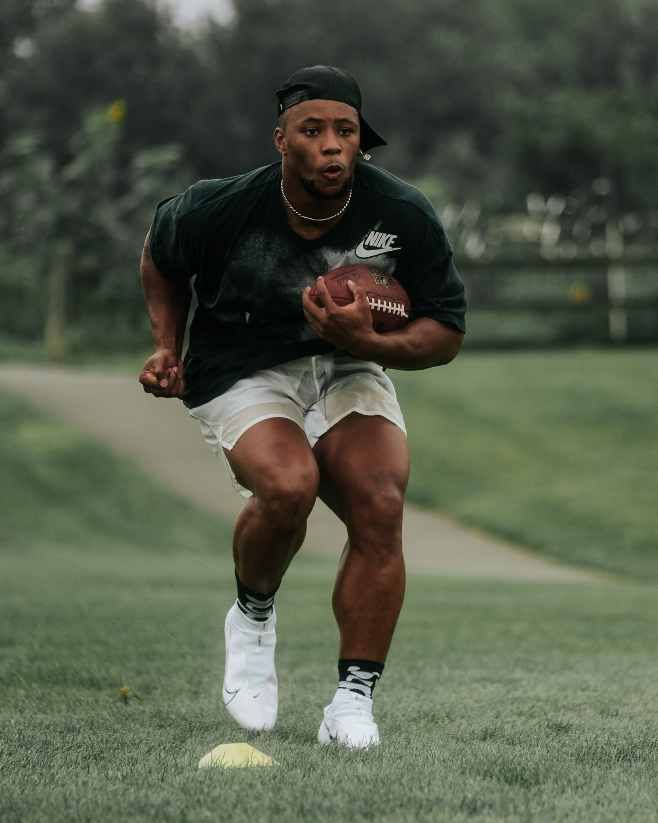
What about the quads?
Current return to sport criteria:
  Quadriceps strength 90% of healthy limb
Quadriceps strength/size is not the only thing that matters
Notes:
Quad (and neural) function
Big quads are nice, but not of value if not used
Functional return may take longer than size return

Slide 34
What about the quads?
Current return to sport criteria:
  Quadriceps strength 90% of healthy limb
Quadriceps strength/size is not the only thing that matters
Costley (2021)
  Found that changes (increases) in quad strength asymmetry had little or no ability to explain changes in concentric/eccentric impulse asymmetry
    Graft type did not influence these findings
Notes:
Quad (and neural) function
Big quads are nice, but not of value if not used
Functional return may take longer than size return

Slide 35
What about the quads?
Quadriceps size is not the only thing that matters
Costley (2021)
  Found that changes (increases) in quad strength asymmetry had little or no ability to explain changes in concentric/eccentric impulse asymmetry
AKA, big, strong quads are nice, but not of value if we can’t use the properly
Notes:
Quad (and neural) function
Big quads are nice, but not of value if not used
Functional return may take longer than size return

Slide 36
What about the quads?
Quadriceps size is not the only thing that matters
Keep in mind: functional return in the quads may take longer than size return
Notes:
Quad (and neural) function
Big quads are nice, but not of value if not used
Functional return may take longer than size return

Slide 37
What about the quads?
Quadriceps size is not the only thing that matters
Keep in mind: functional return in the quads may take longer than size return
Related to how the brain and the ACL communicate
Notes:
Quad (and neural) function
Big quads are nice, but not of value if not used
Functional return may take longer than size return

Slide 38
Return to Sport… When is good?
Psychological factors play a huge role in return to sport timelines
Webster (2018)
  Males: 30% returned back to sport
    Participating frequently in sport before ACL injury = higher psychological readiness
  Females: 17% returned back to sport
    Had more negative outlook and may therefore benefit more from interventions designed to facilitate a smooth transition back to sport
Notes:
Webster: 635 individuals
It could also be that male patients are more reluctant to report their fears and anxieties about RTS, a concept supported by pain perception researchs
Psychological readiness is characterized by low levels of impediments including fear and anxiety and higher levels of such as confidence, motivation, and realistic expectation

Slide 39
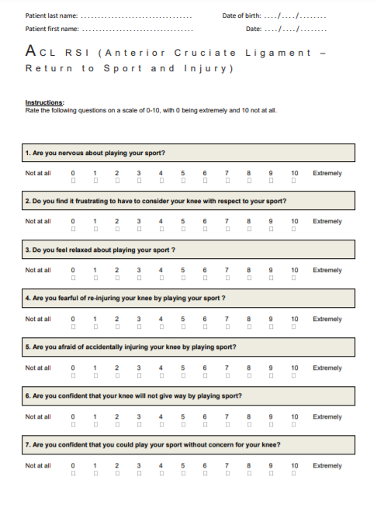
Return to Sport… When is good?
Psychological factors play a huge role in return to sport timelines
Free questionnaires:
  1. ACL-RSI
    Indicates patient’s psychological readiness to return to sport
    Higher the score, more psychologically ready to return to sport
    https://orthotoolkit.com/acl-rsi/
Notes:
Psychological readiness is characterized by low levels of impediments including fear and anxiety and higher levels of such as confidence, motivation, and realistic expectations

Slide 40
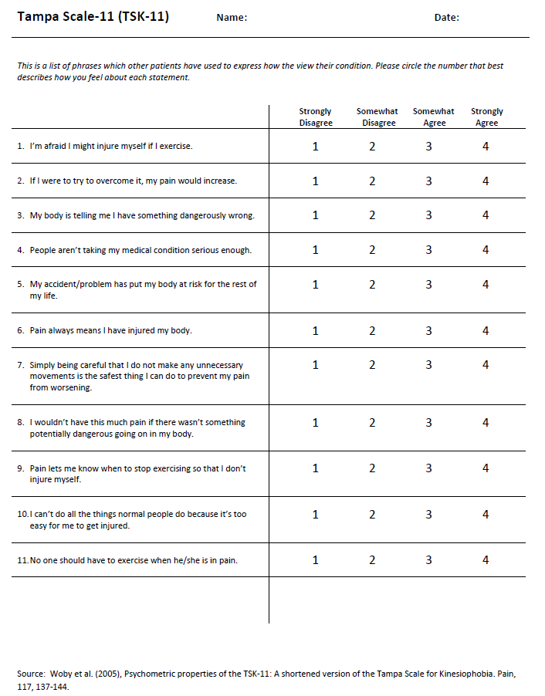
Return to Sport… When is good?
Psychological factors play a huge role in return to sport timelines
Free questionnaires:
  2. TSK-11
    Indicates patient’s general fear of reinjury
    Greater the score, greater the level of kinesiophobia
    https://orthotoolkit.com/tampa-scale-11/
Notes:
fear of reinjuring the knee during activity, fear of the knee giving way during activity, and fear of experiencing knee pain during activity.

Slide 41
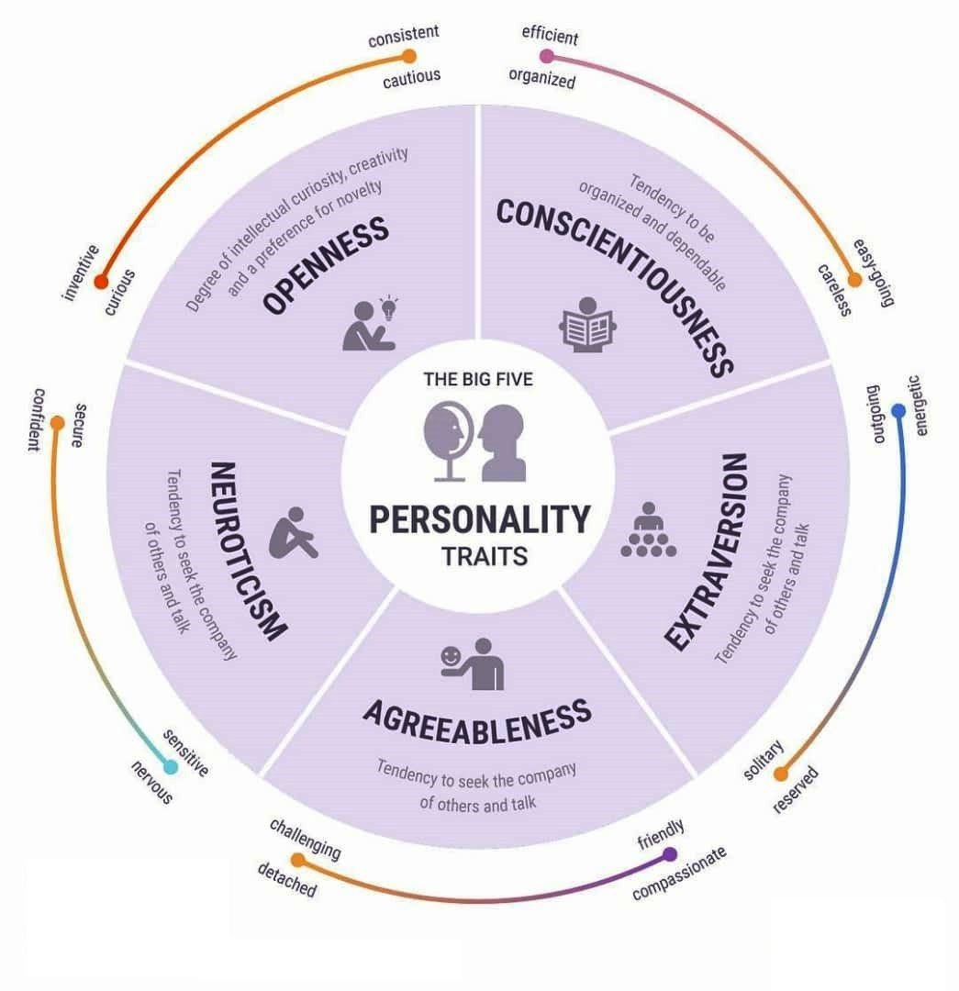
Return to Sport… When is good?
Could individual personality play a role in return to sport?
Notes:
Xu: 155 ACL-R individuals that they gave the Big 5 personality inventory test, along with International Knee Documentation Committee Subjective Knee Score (IKDC), Knee Injury and Osteoarthritis Outcome Score (KOOS), and other subjective knee forms

Slide 42
Return to Sport… When is good?
Xu (2021)
  Neuroticism: negatively correlated with subjective knee scores 3 and 6 months post-surgery
    Odds of poor balance test increased with each 1-point increase in Neuroticism score
  Conscientiousness: positively correlated with subject knee scores at 3 and 6 months post-surgery
    Odds of poor balance test decreased with each 1-point increase in Conscientiousness score
Notes:
Xu: 155 ACL-R individuals that they gave the Big 5 personality inventory test, along with International Knee Documentation Committee Subjective Knee Score (IKDC), Knee Injury and Osteoarthritis Outcome Score (KOOS), and other subjective knee forms

Slide 43
Return to Sport… When is good?
Xu (2021)
  Agreeableness and Openness to experience were positively correlated with subjective knee scores 3 and 6 months post-surgery
During early rehab, personality of the individual may be important
  Could help tailor personalized rehabilitation plans for people of specific personality types
Notes:
Xu: 155 ACL-R individuals that they gave the Big 5 personality inventory test, along with International Knee Documentation Committee Subjective Knee Score (IKDC), Knee Injury and Osteoarthritis Outcome Score (KOOS), and other subjective knee forms

Slide 44
Future directions in ACL Rehab
ACL rehab
Mental Health during Rehabilitation
Brain/ACL connection
Individual Muscle Targeting
Cycling

Slide 45
mental health During rehabilitation
The link between mental health and musculoskeletal injury is strong
Rhon (2021)
  ~19% of male & 28% of female military members diagnosed w/patellofemoral pain had a mental health disorder (MHD) within 2 years after initial physical therapy visit
  Those with MHD had worse knee-related outcomes than those without MHD

Slide 46
mental health During rehabilitation
Psychological factors that influence patient’s return to sport are:
  Psychological readiness
  Fear of reinjury
  Desire to return to sport
The current recommended interventions include psychological rehabilitation in addition to physical rehabilitation to facilitate successful RTS and return to preinjury level of sport

Slide 47
The Brain and the ACL connection
ACL contains mechanoreceptors that are damaged during injury/reconstruction
Afferent feedback loop is disrupted
Decrease in feedback = decrease in motor neuron activation
  Harder to recruit high-threshold motor units
Leads to quad activation/strength deficits

Slide 48
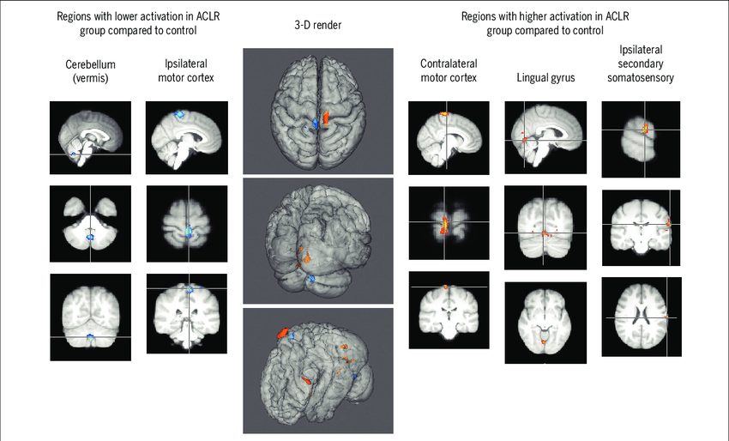
The Brain and the ACL connection
New research suggests that ACL-R individuals need increased visual information processing after surgery
  1. Sensory reweighing from the communication disruption of mechanoreceptors and CNS
  2. Use of visually-dominated exercises and internal feedback to the injured joint during rehab
Notes:
indicate that ACL injury prevention programs could potentially be merged with various motor behavior principles to promote adaptive neuroplasticity to decrease motor coordination errors that lead to injur

Slide 49
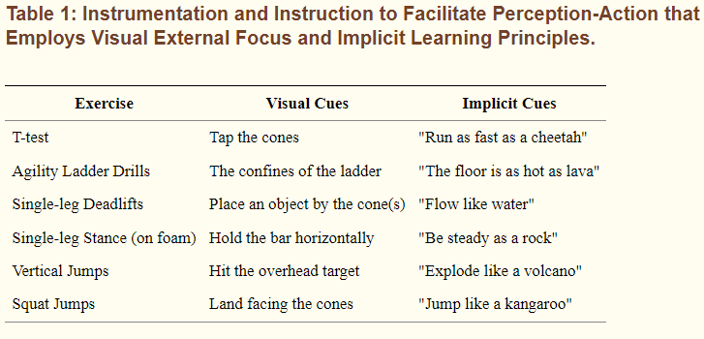
The Brain and the ACL connection
Grooms (2021)
  Motor control and type of focus during rehab important
  External focus prioritizes the movement goal or the movement’s effect on the environment, rather than an internal focus on the movement or body segment itself
Notes:
potentially due to sensory reweighting from the deafferentation of joint mechanoreceptors and/or the use of visually-dominated exercises and internal feedback to the injured joint during physical therapy

Slide 50
The Brain and the ACL connection
Grooms (2021)
  ACL therapy that employs a visual external focus can simulate real-world training scenarios
  Better prepares athletes for return to sport when visual attention is focused on the environment and not the body
Notes:
potentially due to sensory reweighting from the deafferentation of joint mechanoreceptors and/or the use of visually-dominated exercises and internal feedback to the injured joint during physical therapy

Slide 51
The Brain and the ACL connection
Grooms (2021)
  An internal focus approach to therapy may hinder the translational benefits of rehabilitation
  Humans typically navigate the world with a visual external focus on the environment (e.g., running to a ball) – not on their moving joints or mechanics
Notes:
potentially due to sensory reweighting from the deafferentation of joint mechanoreceptors and/or the use of visually-dominated exercises and internal feedback to the injured joint during physical therapy

Slide 52
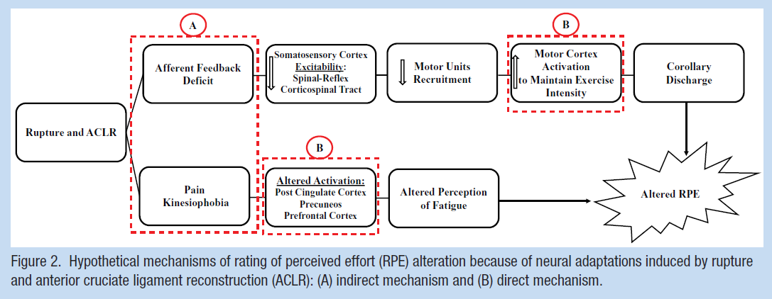
The Brain and the ACL: Implications for rehab?
Rating of Perceived Exertion (RPE)
  Common method used in clinical practice for monitoring, loading control, and resistance training prescription during rehab after ACL-R
ACL-R induce neural adaptations in the brain associated with the patient’s RPE

Slide 53
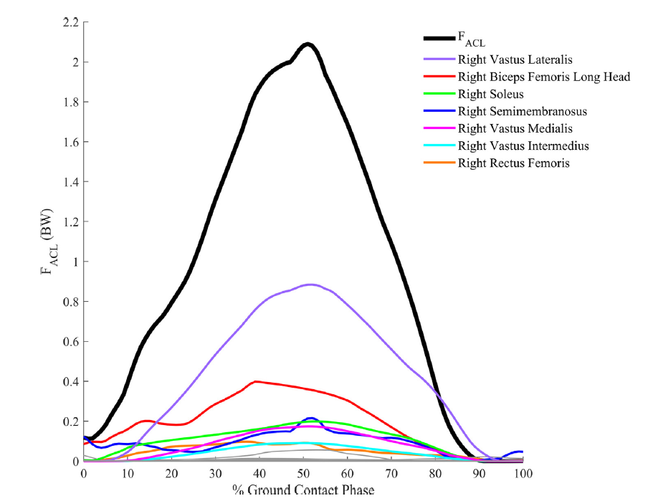
Individual muscle targeting
Muscles directly and indirectly contribute to ACL loading
  Via “dynamic coupling”
Peel (2021)
  Four primary influencers of ACL loading
    Vastus lateralis
    Biceps femoris long head
    Semimembranosus
    Soleus
Notes:
Higher activation of the lateral lower extremity muscles (i.e., vastus lateralis, biceps femoris long head) has been shown to increase knee abduction angle, ACL elongation, and overall ACL injury risk

Slide 54
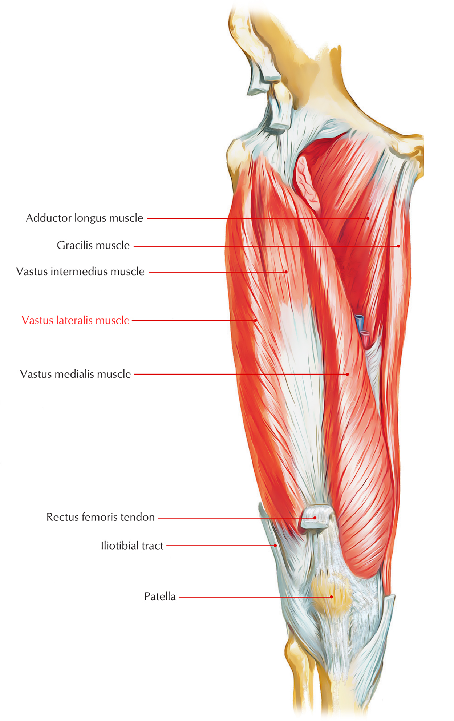
Individual muscle targeting
Vastus lateralis
Zebis (2009)
  Tested EMG activity of 55 elite female athletes during side-cut
  Prospectively tracked ACL incidences for two seasons
  Found that those who experienced an ACL injury had a higher pre-activation of vastus lateralis
Vastus lateralis
Notes:
Higher activation of the lateral lower extremity muscles (i.e., vastus lateralis, biceps femoris long head) has been shown to increase knee abduction angle, ACL elongation, and overall ACL injury risk

Slide 55
Individual muscle targeting
Vastus lateralis
Zebis (2009)
Continue to consider that all quad muscles load the ACL the same, or focus specifically on the vastus lateralis?
Vastus lateralis
Notes:
Higher activation of the lateral lower extremity muscles (i.e., vastus lateralis, biceps femoris long head) has been shown to increase knee abduction angle, ACL elongation, and overall ACL injury risk

Slide 56
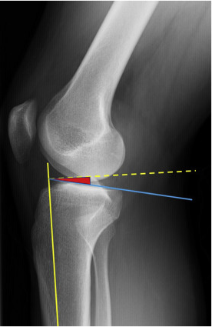
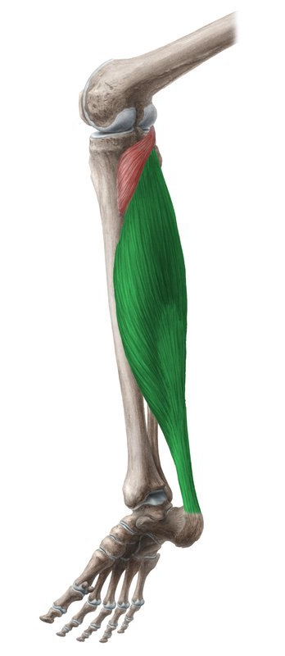
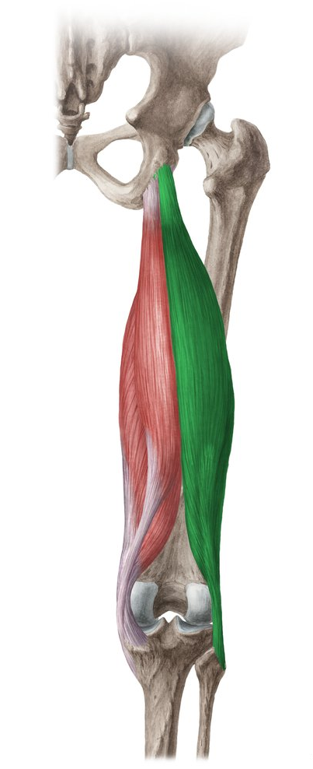
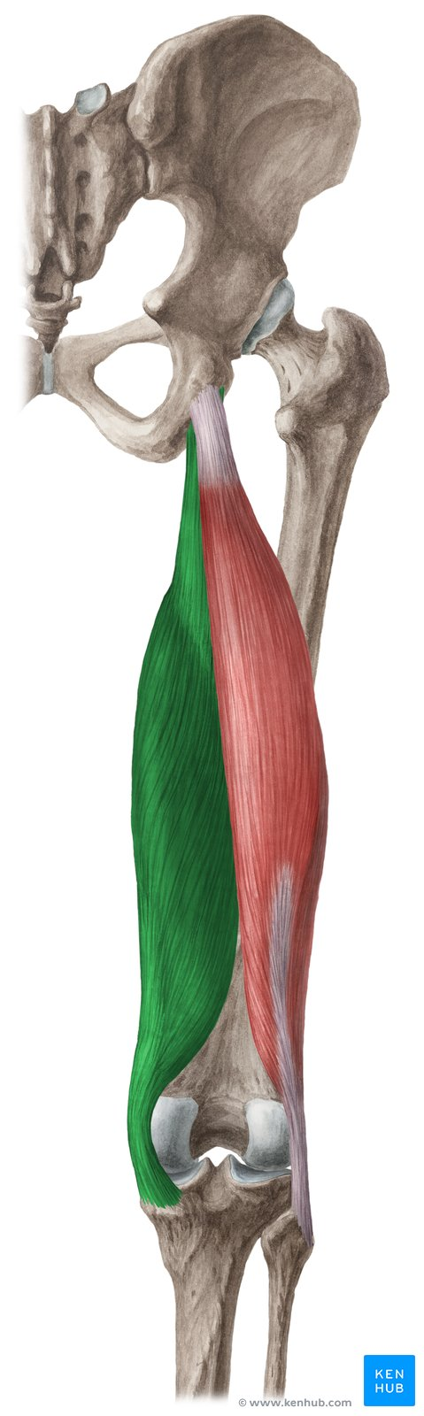
Individual muscle targeting
Soleus
  Acts to resist anterior tibial translation at the ankle
Biceps femoris long head
  Acts to resist posterior GRF during dynamic tasks
Semimembranosus
  Largest contributor to compressive joint reaction force
Posterior tibial slope
Posterior tibial slope in combination with a flexed knee will cause the tibia to move forward relative to the femur
Increase strain on the ACL
Notes:
Soleus: Hypothesized to have the same role at the knee
Bi Fem: Potentially indirectly loads ACL due to dynamic coupling
Semimembranosus: When contracted, draws the tibia into the femur
Higher activation of the lateral lower extremity muscles (i.e., vastus lateralis, biceps femoris long head) has been shown to increase knee abduction angle, ACL elongation, and overall ACL injury risk

Slide 57
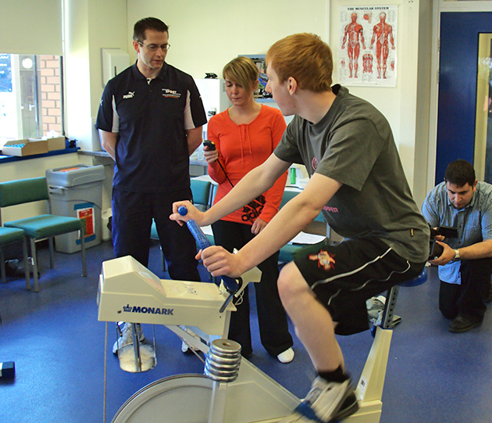
Cycling as a rehabilitation tool?
Cycling in ACL rehab can be introduced as early as 10 days post-ACL-R (once 110° of knee flexion has been reached).
Notes:
Six different riding conditions were evaluated: three power levels (75, 125, and 175 W), each of which was performed at two cadences (60 and 90 rpm).
No significant differences were found in peak strain values due to changes in power level or cadence.

Slide 58
Cycling as a rehabilitation tool?
Cycling in ACL rehab can be introduced as early as 10 days post-ACL-R (once 110° of knee flexion has been reached).
Fleming (1998) reported low ACL strain values during different cadences and power levels in stationary cycling
Notes:
Six different riding conditions were evaluated: three power levels (75, 125, and 175 W), each of which was performed at two cadences (60 and 90 rpm).
No significant differences were found in peak strain values due to changes in power level or cadence.

Slide 59
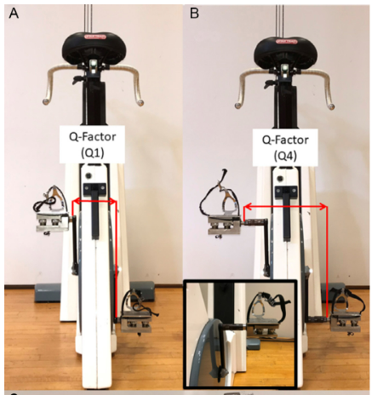
Cycling as a rehabilitation tool?
Modifications to cycle ergometer parameters (i.e. Q-factor) are currently being investigated for total knee replacement and knee osteoarthritis rehabilitations

Slide 60
Cycling as a rehabilitation tool?
Modifications to cycle ergometer parameters (i.e. Q-factor) are currently being investigated for total knee replacement and knee osteoarthritis rehabilitations
  Allows for manipulation of force application to the knee joint
  Targets desired loading on specific aspects of the knee joint

Slide 61
Cycling as a rehabilitation tool?
Modifications to cycle ergometer parameters (i.e. Q-factor) are currently being investigated for total knee replacement and knee osteoarthritis rehabilitations
  Allows for manipulation of force application to the knee joint
  Targets desired loading on specific aspects of the knee joint
Future work needed to investigate implications for ACL-R rehab

Slide 62
Take Homes
More focus on muscle function

Slide 63
Take Homes
More focus on muscle function
Increase in neuromuscular training
Increase use of External Focus during rehabilitation

Slide 64
Take Homes
More focus on muscle function
Increase in neuromuscular training
Increase use of External Focus during rehabilitation
Work closely with the mental component of injury

Slide 65
Take Homes
More focus on muscle function
Increase in neuromuscular training
Increase use of External Focus during rehabilitation
Work closely with the mental component of injury
Partner with mental health specialists/use mental health questionnaires

Slide 66
Take Homes
More focus on muscle function
Increase in neuromuscular training
Increase use of External Focus during rehabilitation
Work closely with the mental component of injury
Partner with mental health specialists/use mental health questionnaires
Don’t rush the rehabilitation process

Slide 67
Take Homes
More focus on muscle function
Increase in neuromuscular training
Increase use of External Focus during rehabilitation
Work closely with the mental component of injury
Partner with mental health specialists/use mental health questionnaires
Don’t rush the rehabilitation process
Better to delay a return to sport than return to early

Slide 68
Questions?
Email: Shelby.peel@usm.edu
Twitter: @Shelbypeel_usm
Notes:
Thank organizers of Tri-State APTA meeting

