Slide 1


Leveraging Our Past,
Building Our Future
Susan A Appling, PT, DPT, PhD
Tri State Conference
October 2, 2021
Notes:
Good morning and welcome to the OPTA LEAP Conference.
I’m Susan Appling and I’m here to talk with you today about APTA’s Centennial.
I have served as the Centennial Steering Committee chair for the past 4 years and I’m happy to tell you about all that has and is going on.

Slide 2









My Journey…….
Notes:
Should I keep this?

Slide 3
Objectives
Review relevant APTA history
01
Discuss APTA’s Centennial Year
02
Discuss APTA & Component resources for practice, education, and research
03
Small Group Discussions on presented topics
04

Slide 4
Some Historical Perspective…

Slide 5
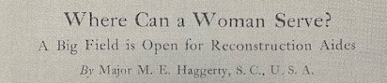
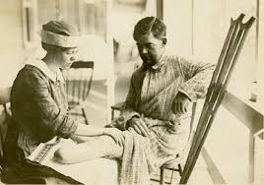
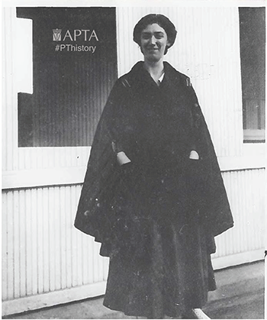
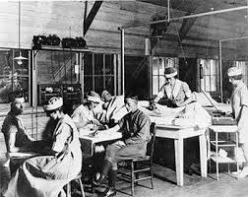
The Prequel…
World War I
Notes:
Mary McMillan, having been trained in Liverpool and London worked in physical therapy and massage, first worked in Liverpool in 1910.
In 1914, the Great War broke out. Mary returned to the US and took a position at the Children’s Hospital in Portland, MN. She taught others in medical gymnastics and massage. The first major polio epidemic happened in 1916 and she helped train people to treat those affected.
In September 1917 that the Army establish a physical therapy training course at the Soldiers' Home, Washington, D.C., for both physical therapists and enlisted men. The plan began to materialize in 1918.
In 1918, Mary McMillan was sworn in as the first Reconstruction Aide, as a member of the US Army Medical Corp and was stationed at Walter Reed General Hospital. Marguerite Sanderson was the Syupervisor of the Reconstruction Aides, and Mary McMillan would manage the operations at the hospital.
June 6, 1918, the first reconstruction aides were sent to Europe to begin their work for those wounded on the battlefield. As the number of wounded grew, along with the need for more reconstruction aides, 40 Reconstruction Hospitals were ordered to be built around the country in 1918. In addition, the number of schools for “war reconstruction aides” grew to 14 and Mary was granted leave from Walter Reed to became the Director of Reconstruction Aides at Reed College in Portland, OR.
Since the training of physical therapists had never before been attempted in this country, The Surgeon General invited several prominent educators to a conference in his office to discuss the problem which confronted him. As a result of this conference, an appeal was made to physical education schools to cooperate in establishing short intensive emergency physical therapy training programs. Early in 1918, The Surgeon General approved the outlines and plans submitted by the schools which were willing to undertake this training. In April, emergency physical therapy courses were initiated at the following institutions: American School of Physical Education, Boston, Mass.; Boston School of Physical Education, Boston, Mass.; Prose Normal School of Gymnastics, Boston, Mass.; New Haven Normal School of Gymnastics, New Haven, Conn.; Normal School of Physical Education, Battle Creek, Mich.; and Reed College, Portland, Oreg.
The largest enrollment was at Reed College where 200 students representing 72 universities or colleges and 31 states attended the second course.8 In June 1918, at the urgent request of the president of Reed College, The Surgeon General granted Miss McMillan leave of absence from Walter Reed General Hospital to accept the position of director
By 1919, 45 hospitalsthrought the US had physiotherapy facilities and employed over 700 Reconstruction Aides.
In 1920, Reconstruction Aides became physical therapists. That same year, Mary resigned from the US Army.
Mary McMillan is considered the “Mother of Physical Therapy.”

Slide 6
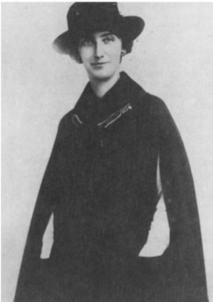

The Beginning of APTA…
January 15, 1921 at Keen’s Chophouse, NYC
A call to Reconstruction Aides
120 women formed the American Women’s Physical Therapeutic Association
”I shall do everything in my power during my term of office to live up to the trust and confidence bestowed upon me.”
Mary McMillan
Notes:
Most of you have likely heard the story of the beginning of APTA. A group a women, led by Mary MacMillan gathered at Keen’s Chophouse in New York City.
There were about 30 aides, as well as about 5 physicians who had served in the Army or Navy.
WWI had just ended
Throughout the war, reconstruction aides, the predecessors to PTs, worked to do their part, treating the casualties of war and getting soldiers back on their feet. These strong women had proven their value as medical professionals – war heroes – and shown that those who would eventually be known as physical therapists had a major role to play in the future of America’s health.
Once the war was over the reconstruction aide program at Walter Reed General Hospital was to be dismantled. Mary McMillan and her colleagues wanted to build on the momentum of the war, preserve the resources that had been developed, and ensure that the core group of people was maintained. To do that, they formed the American Women’s Physical Therapeutic Association. (AWPTA). Inviting some 800 candidates, 120 women joined the AWPTA. A year later, the association changed it’s name to the American Physiotherapy Association.
Mary McMillan was the first president of the organization. Because of her work with the Army, and her teaching physical therapy, especially in the early days during the war, and as the first president, Mary McMillan is known as the “Mother of Physical Therapy”

Slide 7
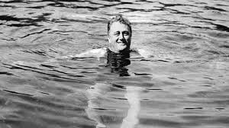
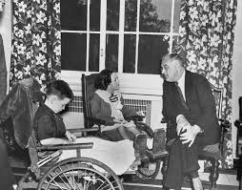
Post-War Work
“One of the results of the World War was the universal recognition of the value of physiotherapy…The success attained in the army was in great measure due to the loyalty, the contagious enthusiasm, the professional ability and the whole-souled devotion to duty, of you, the Reconstruction Aides in physiotherapy.”
        The “P.T. Review,” Vol 1, Issue 1, March, 1921
Physical Therapy Patients
  War veterans
  Those with poliomyelitis
  Survivors with disabilities
Notes:
After the war, physical therapist worked in hospitals, with veterans, children, and those injured in industrial accidents. Polio continued to rage in the country and physical therapists were there.
In 1921, VP Franklin Delano Roosevelt was diagnoses with polio and sought treatment at Warm Springs, GA
Physical therapists practiced in hospitals, clinics, and also provided home care for those with polio

Slide 8

The Early Years
1920s
  NYU offered BS for physical therapy
  Standards for accreditation developed
  Name changed to American Physiotherapy Association
1930s
  Incorporated in the state of Illinois
  Code of Ethics
  American Registry of Physical Therapy Technicians
Notes:
NYU BS 1927
Accreditation 1928
1940s
Membership grew to over 1000
Worthingham served 5 years as president
World War II and reactivation of physical therapists in uniform, and were recognized as part of Army Medical Department
orld War II was raging and there was a continuing need to quickly increase the number of trained physical therapists to meet the demands of war. The success of Emma Vogel’s 1941 War Emergency Training Course of WW II led to the launch of several more across the country, among them the Special Women’s Medical Service Corps Program for African-Americans at Fort Huachuca, Arizona, which was set up in 1943. The physical therapists who came out of that program were subsequently posted to the 944-bed station hospital there or to other smaller hospitals overseas.

Slide 9
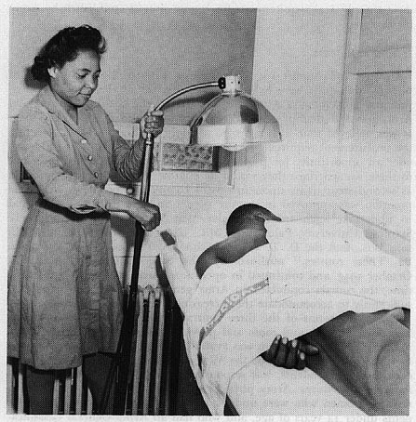
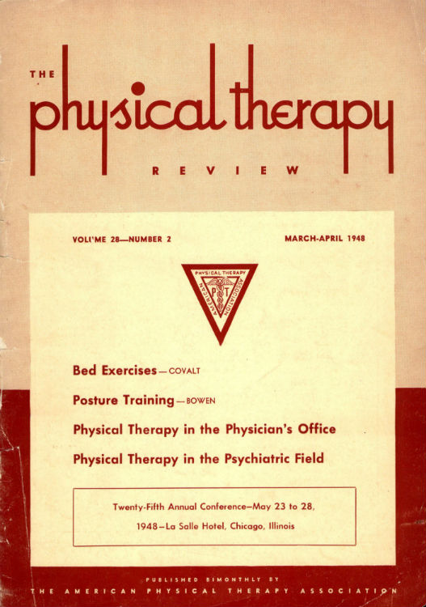
The Early Years
1940s
  World War II
  Training program for African-Americans in AZ
  First headquarters in NYC
  House of Delegates formed
  Name change to APTA
Notes:
NYU BS 1927
Accreditation 1928
1940s
Membership grew to over 1000
Worthingham served 5 years as president
World War II and reactivation of physical therapists in uniform, and were recognized as part of Army Medical Department
orld War II was raging and there was a continuing need to quickly increase the number of trained physical therapists to meet the demands of war. The success of Emma Vogel’s 1941 War Emergency Training Course of WW II led to the launch of several more across the country, among them the Special Women’s Medical Service Corps Program for African-Americans at Fort Huachuca, Arizona, which was set up in 1943. The physical therapists who came out of that program were subsequently posted to the 944-bed station hospital there or to other smaller hospitals overseas.

Slide 10
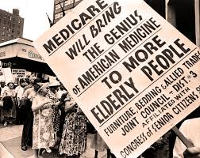
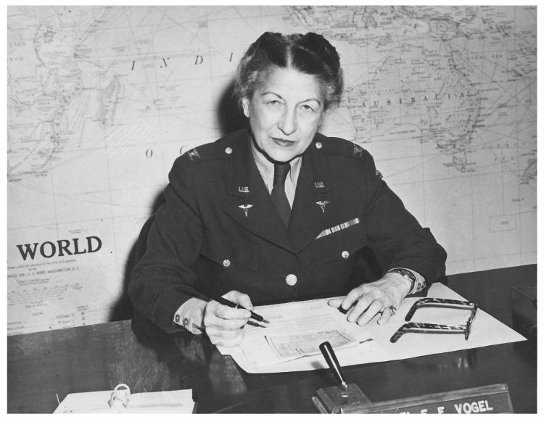
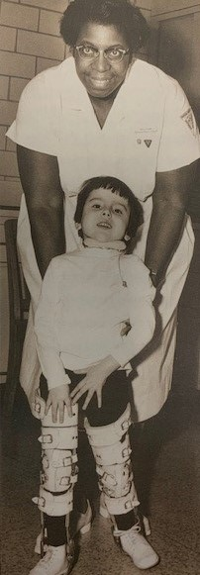
The Middle Years
1950s
  Korean War & Women’s Medical Specialist Corp
  Standardized exam for state licensure
  Formation of Sections
    Section on Self-employed (PPS)
    Schools Section (Academy of Education)
  Physical Therapy Fund established (FPTR)
  Polio vaccine developed
1960s
  Graduate education in physical therapy
  Mary McMillan Lecture established
  Medicare passed Congress
  Vietnam War and PT deployment
  First Physical Therapist Assistants graduate
Notes:
ongress had just passed a law establishing the Women’s Medical Specialist Corps (WMSC) within the U.S. Army in 1947. Major Emma E. Vogel was chief officer of the corps and promoted to the rank of colonel. This law provided for the first time full military recognition for women physical therapists serving in the armed services. Vogel’s all-women command had scarcely adjusted to its new status when the United States found itself once again at war, this time in Korea. And, as with the last two world wars, the military services were woefully short on PTs, with less than 300 in service to care for an army that, when fully mobilized, totaled 1.5 million men. Combat in Korea was fierce, and casualties were heavy. Several members of the WMSC were recognized for exceptional service during the war,
The World Confederation for Physical Therapy held its first formal meeting in Copenhagen. Mildred Elson, APTA’s first executive director, was elected to serve as WCPT’s first president. Five years later, in 1956, APTA would cohost the second WCPT World Congress in New York City, where Elson would be one of the dignitaries on hand as WCPT honored Jonas Salk for the introduction of his widely acclaimed Salk vaccine for polio the previous year.
Over the years there had been many articles in Physical Therapy Review about physical therapists providing better scientific data on their work, one of the hallmarks of a true profession. A few members obliged with worthy contributions to the research literature. Among the more impressive works were Margaret Moore’s three-part “Goniometric Measurements” (1949) and Marian Williams’ comprehensive “Manual Muscle Testing, Development and Current Use” (1956), both of which appeared in the Review. But, as a rule, physical therapists were too busy practicing their profession to find the time and funds needed to undertake and record well-documented studies.
In 1955, E. Jane Carlin, speaker of the House, and Mildred O. Elson, APTA’s executive director, brought before the House of Delegates the idea of establishing an internal fund to foster scientific, literary, and educational projects in physical therapy. After lengthy discussions, the House gave the proposal an enthusiastic go-ahead, and in 1957 the Physical Therapy Fund was established. The fund was incorporated as a separate entity under the laws of the state of New York, with APTA as sponsoring agent. By April 17, 1957, 431 contributors — including Mary McMillan — had donated a total of $5,889.75 to the fund. Contributions ranged from $1 to $1,000. By the end of 1957, the fund had met all the legal requirements to be a tax-exempt nonprofit corporation.
PT Fund precursor to FPTR

Slide 11
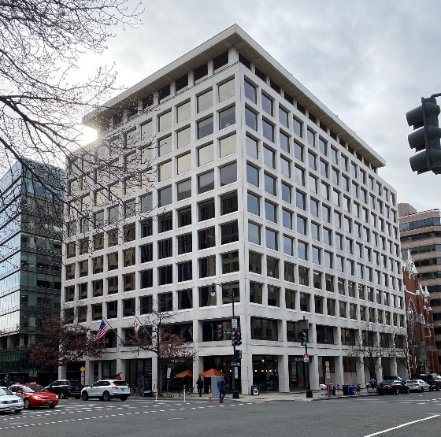

The Middle Years
1970s
  PTA membership in APTA
  APTA moves to Washington, DC
  First PhD Program in PT
  First PT program in HBCU
  First CSM
  APTA recognized as credentialing agency
1980s
  House of Delegates sets path for post-bacc degree
  APTA moves to Alexandria
  First specialist certification exams
  Minority Scholarship Fund established
  Affiliate Assembly established
Notes:
Mary McMillan died in 1959.
The earliest and most prestigious recognition offered by APTA for achievement is the Mary McMillan Lecture Award, which was established in 1962 by the Board of Directors in memory of the association’s beloved first president and physical therapy trailblazer. Mildred O. Elson delivered the first lecture in 1964, and Helen J. Hislop, editor of Physical Therapy, turned Elson’s memorable remarks, “The Legacy of Mary McMillan,” into a booklet that was broadly used in schools and clinics to introduce students to the history of the profession.
Among the many initiatives launched during Lyndon Johnson’s presidency, none had a greater impact on physical therapists than enactment in 1965 of the Medicare and Medicaid programs. Medicare (which was appended to the 1935 Social Security Act as Title XVIII) provided federal funding for many of the medical costs of older Americans and the disabled. It overcame deeply entrenched resistance to what had been perceived as “socialized medicine” by making benefits available to everyone over 65 regardless of financial need; by linking payments to the existing private insurance system; and by allowing patients to choose their medical providers in the open market. Medicaid extended the insurance concept to recipients of all ages and was administered by the states with a combination of federal and state funding.
The effects of the two programs were far-reaching. Many millions of people previously receiving little or no health care suddenly gained access, with the result that the market, and the need for skilled personnel in virtually every sector of health care expanded dramatically. As Catherine Worthingham noted at a symposium at the 1964 Annual Conference in Denver, “The dilemma with which physical therapy is faced is that there are not enough physical therapists to perform the [current] essential physical therapy services.” With national insurance legislation on the verge of going into effect, she warned, the problem might well become so severe that others could decide to solve it for them if physical therapists persisted in “playing ostrich with their collective heads in the sand.”
Of note, Medicare as initially enacted contained no provisions for covering the services of physical therapists in independent practice. Beginning in 1966, two members of Section on Self-Employed, Clem G. Eischen and John Pellow, led the charge to have the services of private practice PTs included. Congress passed new legislation before the end of 1967, and as a result of the profession’s efforts the Medicare and Medicaid included the services of private practitioners. What’s more, as the decade closed the reimbursement limit of $100 was raised to $500, an astonishing change of heart on the part of congressional watchdogs.
Howard--1975

Slide 12
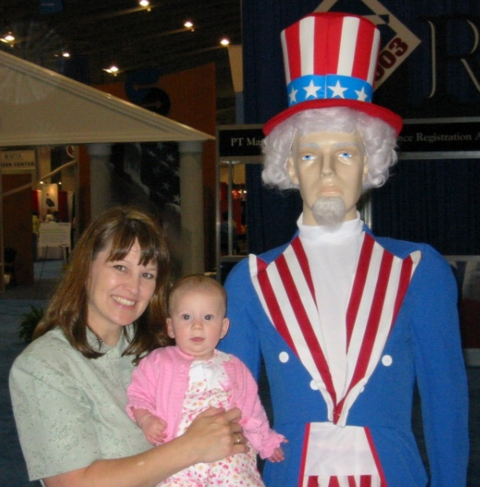
The Later Years
2000s
  APTA Vision 2020
  Physical therapy, by 2020, will be provided by physical therapists who are doctors of physical therapy and who may be board-certified specialists.
  First Credentialed Residency & Fellowship Programs
  PT Day on the Hill
  Licensure in all 50 states
  PTA Caucus established
  PT-CAS

Slide 13


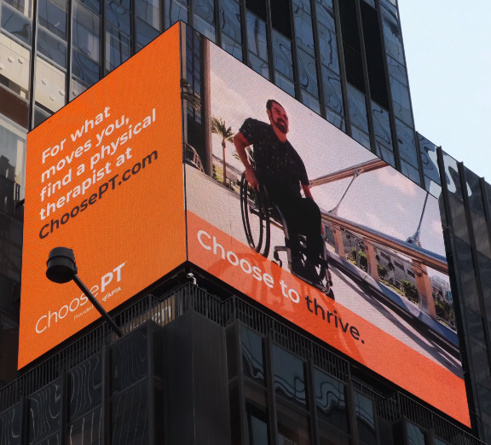

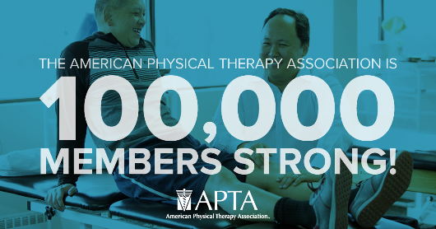
Recent Years
2010s
  ACA passes Congress
  New Vision Statement
  Direct Access (some form) achieved in all 50 states
  Full vote for PTA at component level
  New Mission Statement
Notes:
Add groundbreaking picture

Slide 14
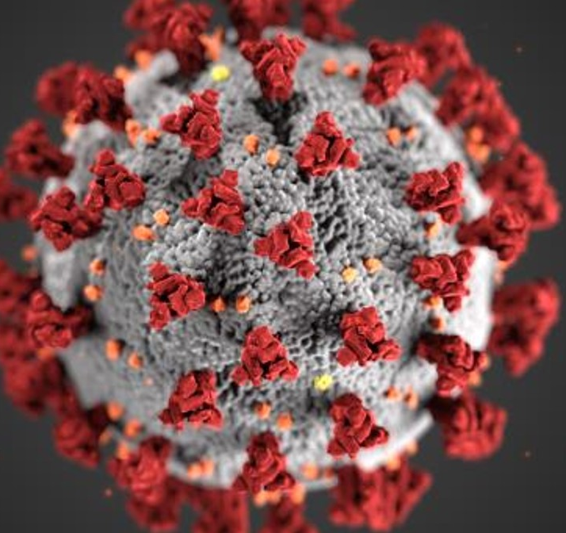
COVID-19: APTA & Members Respond
Highlights include:
Board guidance on “professional judgment.”
News and resources from APTA national and components.
Post-Acute COVID-19 Exercise and Rehabilitation (PACER) project.
Post-intensive care syndrome (PICS) courses.
Core outcomes measures.
Impact Reports
Teamwork!

Slide 15
Small Group Discussion
Identify 3-5 historical markers in APTA history that directly influence your work today.
How have these markers influenced you in your career?

Slide 16
Our Second Century…

Slide 17
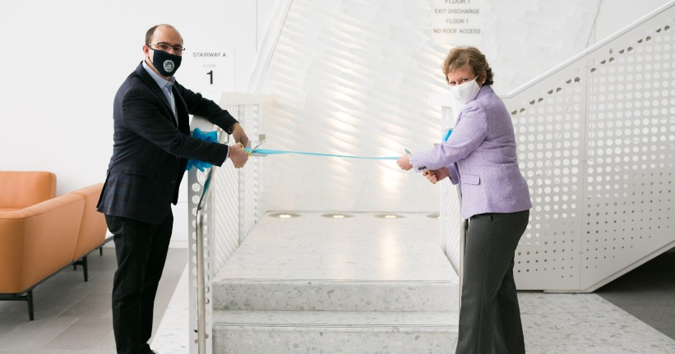

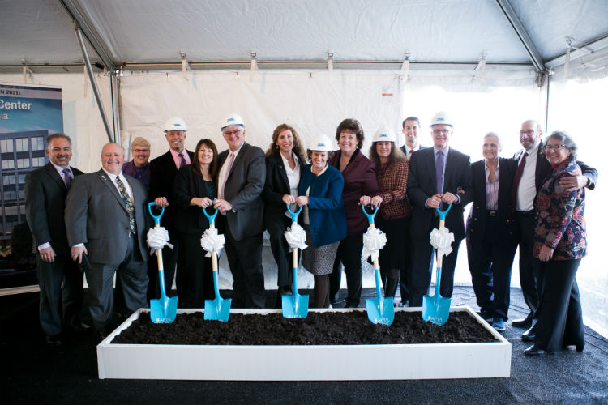
A New Century Dawns
Jan. 15, 2021: On the 100th anniversary of our founding, we kicked off our centennial with two special events:
Ribbon Cutting
Founders’ Day Celebration
Notes:
On APTA Founder’s Day, January 15th, APTA kicked off it’s 100th birthday celebration.
We started with the ribbon cutting for our new APTA home at 3030 Potomac in Alexandria, VA
On the dawn of our 100th birthday, this picture of our new building was taken.
Here are pictures from the groundbreaking a couple of years ago and the ribbon cutting,
Video: APTA Centennial Center overview: https://youtu.be/u09PGal02Cc (2:26).
Search “Ribbon Cutting” at apta.org to see the full Jan. 15 event.

Slide 18

APTA Centennial Center
“APTA Centennial Center embodies our profession’s values.”
Stairways encourage movement
Collaboration space for teamwork
Abundant natural light
Access to recreational trails
Special bike entrance and storage
Access to Metro (coming in 2022)
First D.C. area building to earn FitWel’s highest ranking

Slide 19

Watch the Ribbon Cutting to See Building Highlights
Video: APTA Centennial Center overview: https://youtu.be/u09PGal02Cc (2:26).
Search “Ribbon Cutting” at apta.org to see the full Jan. 15 event.

Slide 20

Watch the APTA Founders’ Day Celebration at apta.org
Search “Founders’ Day Celebration” at apta.org to see the full Jan. 15 event.

Slide 21
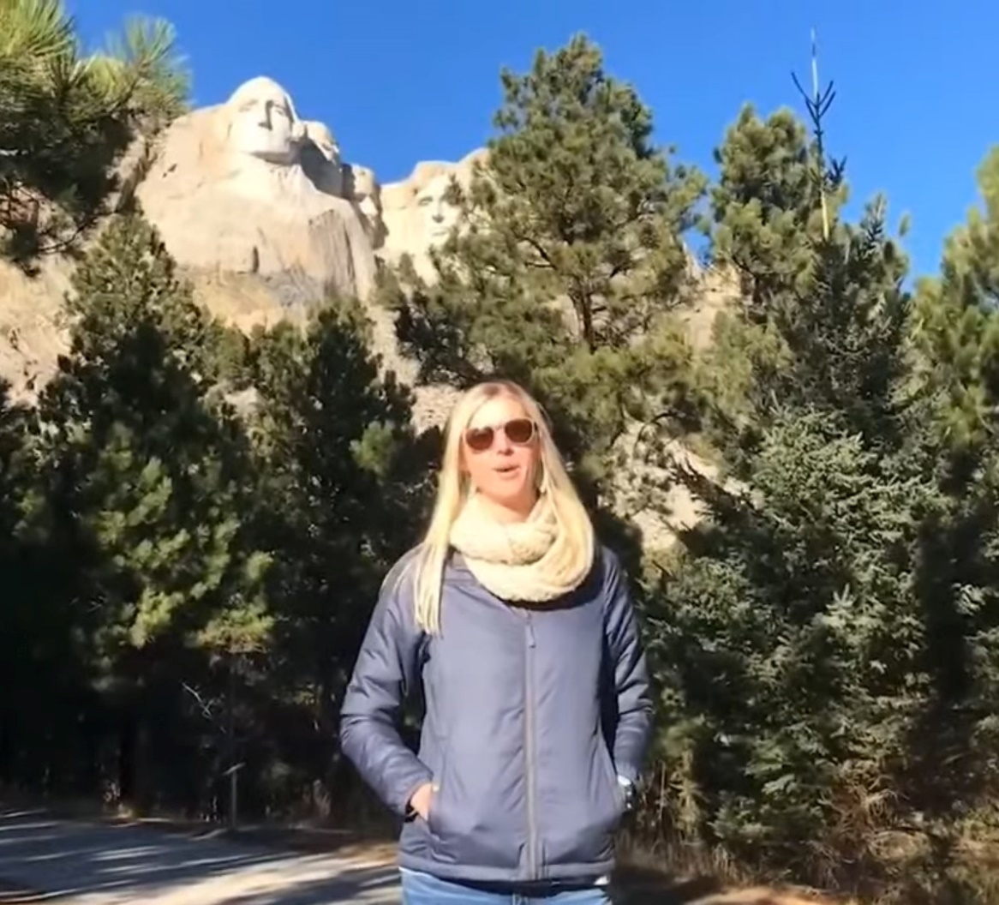
APTA Founders’ Day Celebration
“Tonight is about community.”
Live interviews with President Sharon Dunn, CEO Justin Moore, Centennial Scholars, and more.
65 video tributes from our components!
Historical milestones from our first 100 years.

Slide 22
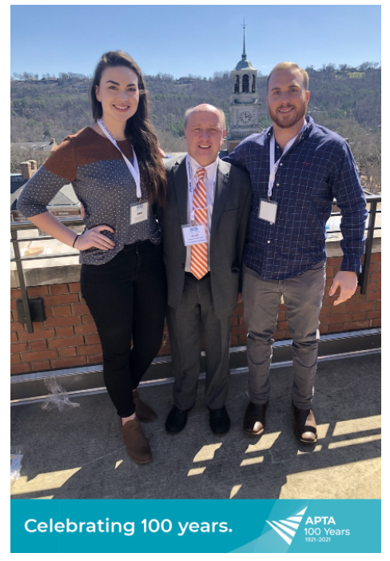
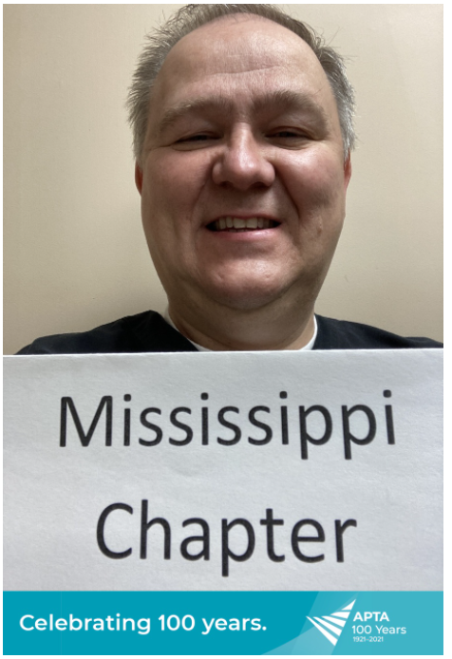

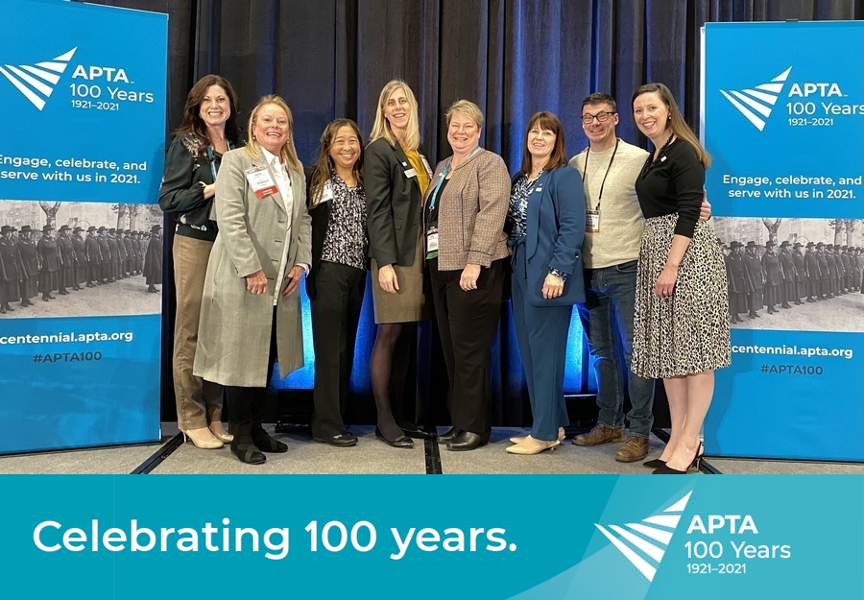
APTA Founders’ Day Celebration
Launched the APTA Mosaic
Notes:
On that evening, APTA hosted a livestream Founder’s Day Celebration
65 components sent tribute videos
We launched the Centennial Mosaic, which is available as a poster, but is interactive on the centennial.apta.org microsite. I hope you submitted your picture for the mosaic.

Slide 23

Virtual APTA Combined Sections Meeting
Record 15,000+ registrants!
APTA CSM overview:
Live programming throughout February.
Registrants got an all-access pass to content thru March.
Digital posters with audio descriptions by presenters.
Up to 2.0 CEUs (20 contact hours).

Slide 24

Our New Public Service Announcement Launched in February!
Our two previous PSAs generated $9 million+ in donated airtime on TV and radio.
PTs: Go to ChoosePT.com and ensure your Find a PT profile is updated.
Notes:
PSA Statistics: The 2021 Choose to Move PSA has reached 27 states and 40 markets. The PSA has been placed in 6,694 spots and had 26,068,200 total impressions equaling $701,750 in total donated airtime. The PR team is determining which geographic areas haven’t aired the PSA and working with the chapters in those areas to push the PSA to their local networks. • National Physical Therapy Month: National Physical Therapy Month begins Friday. The webpage for members promotes 100 Days of Service for the centennial, the annual PT Day of Service, and resources for members to use in engagement with consumers.

Slide 25
Together to Celebrate APTA’s Centennial …

Slide 26
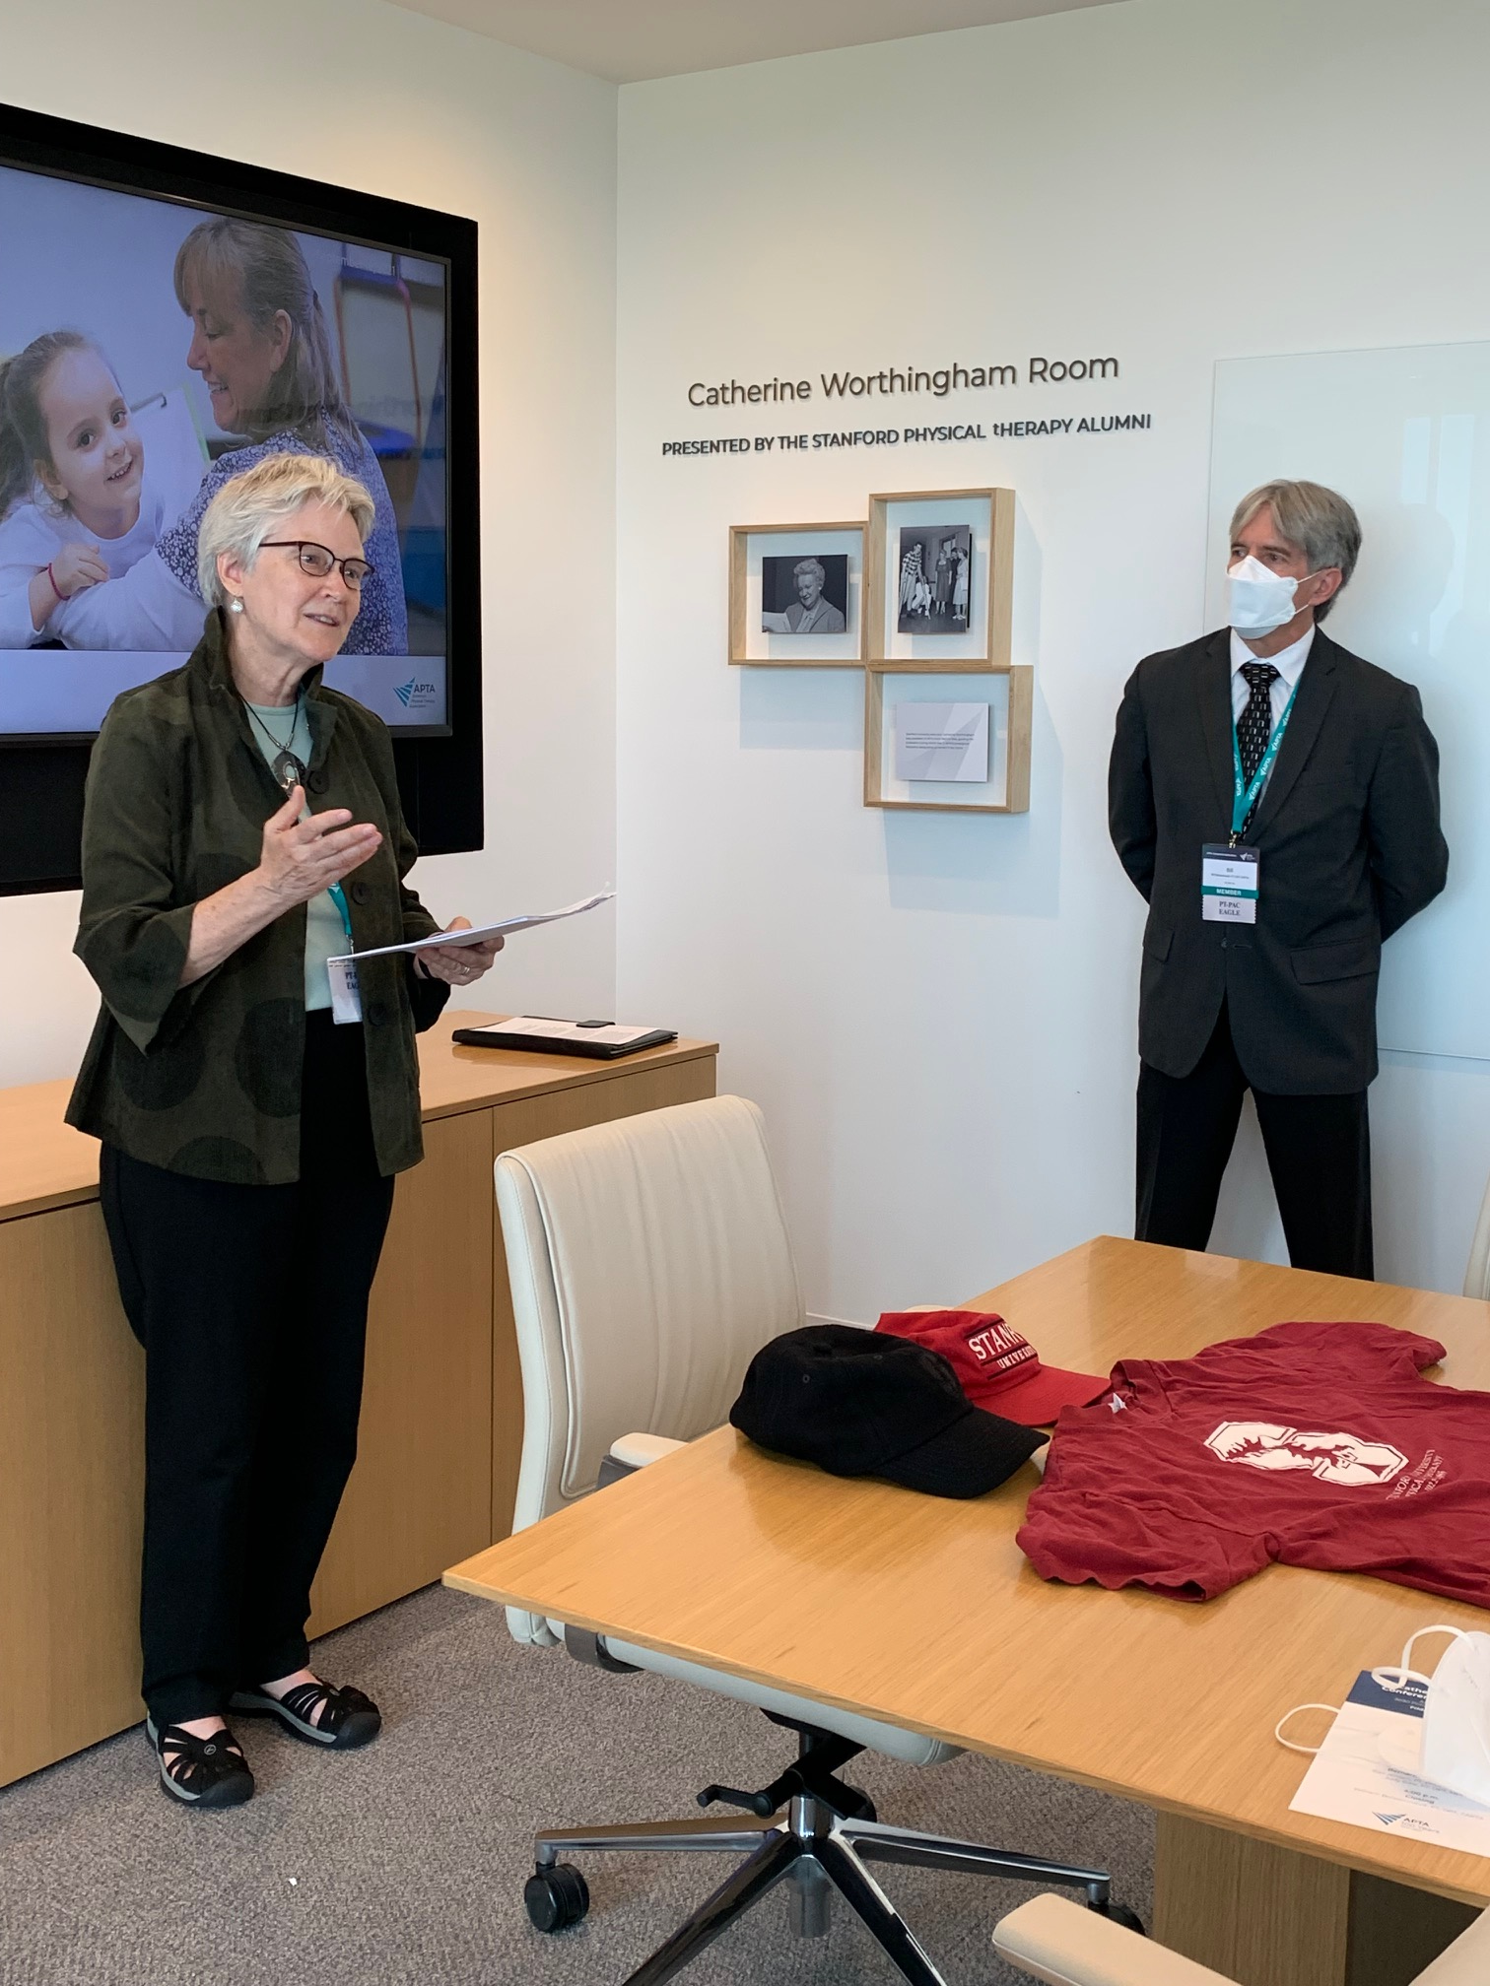
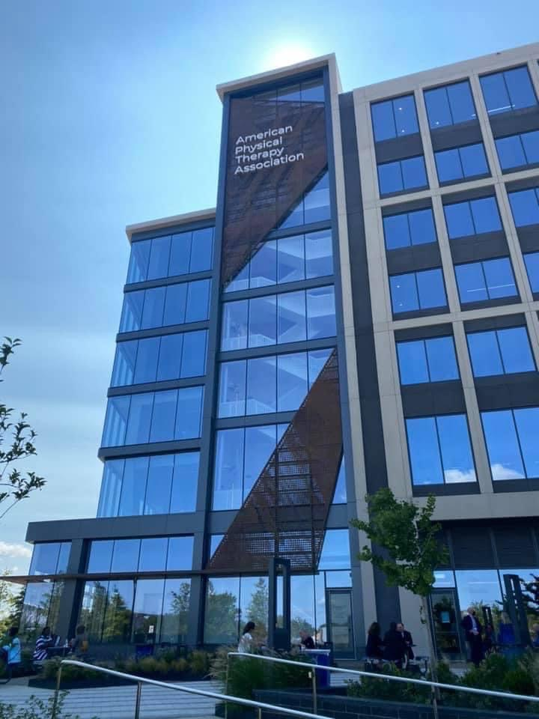
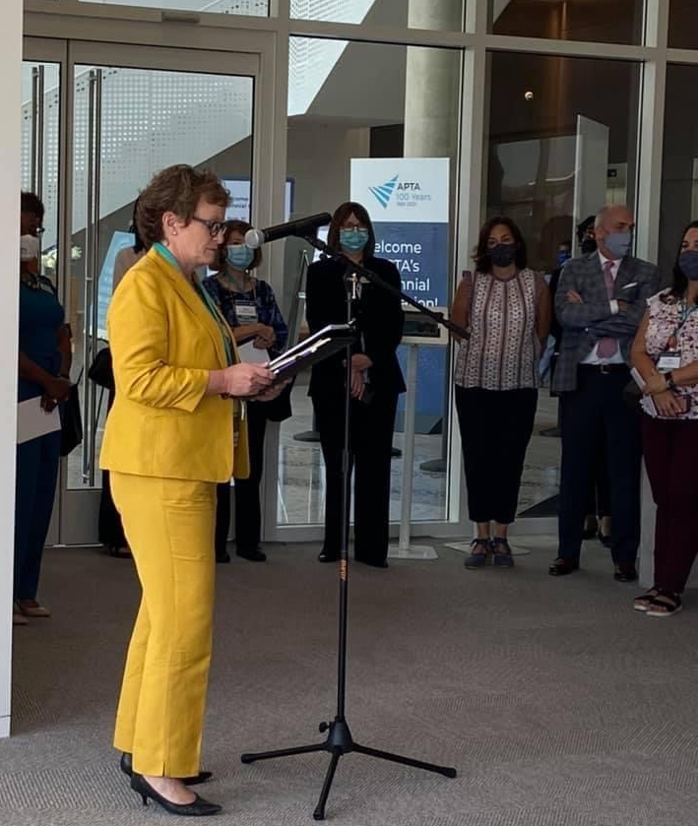
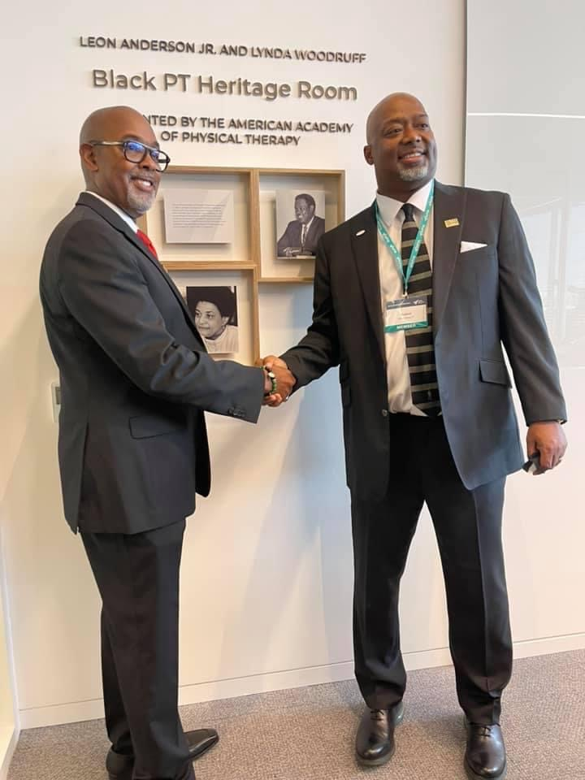
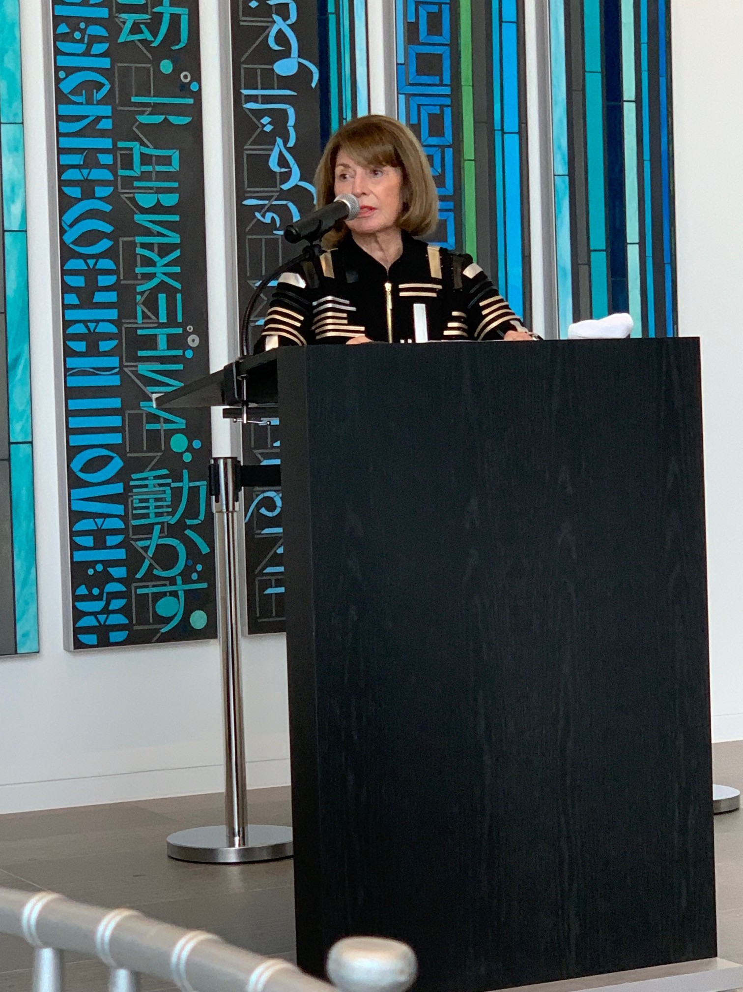
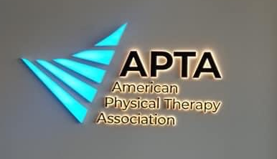


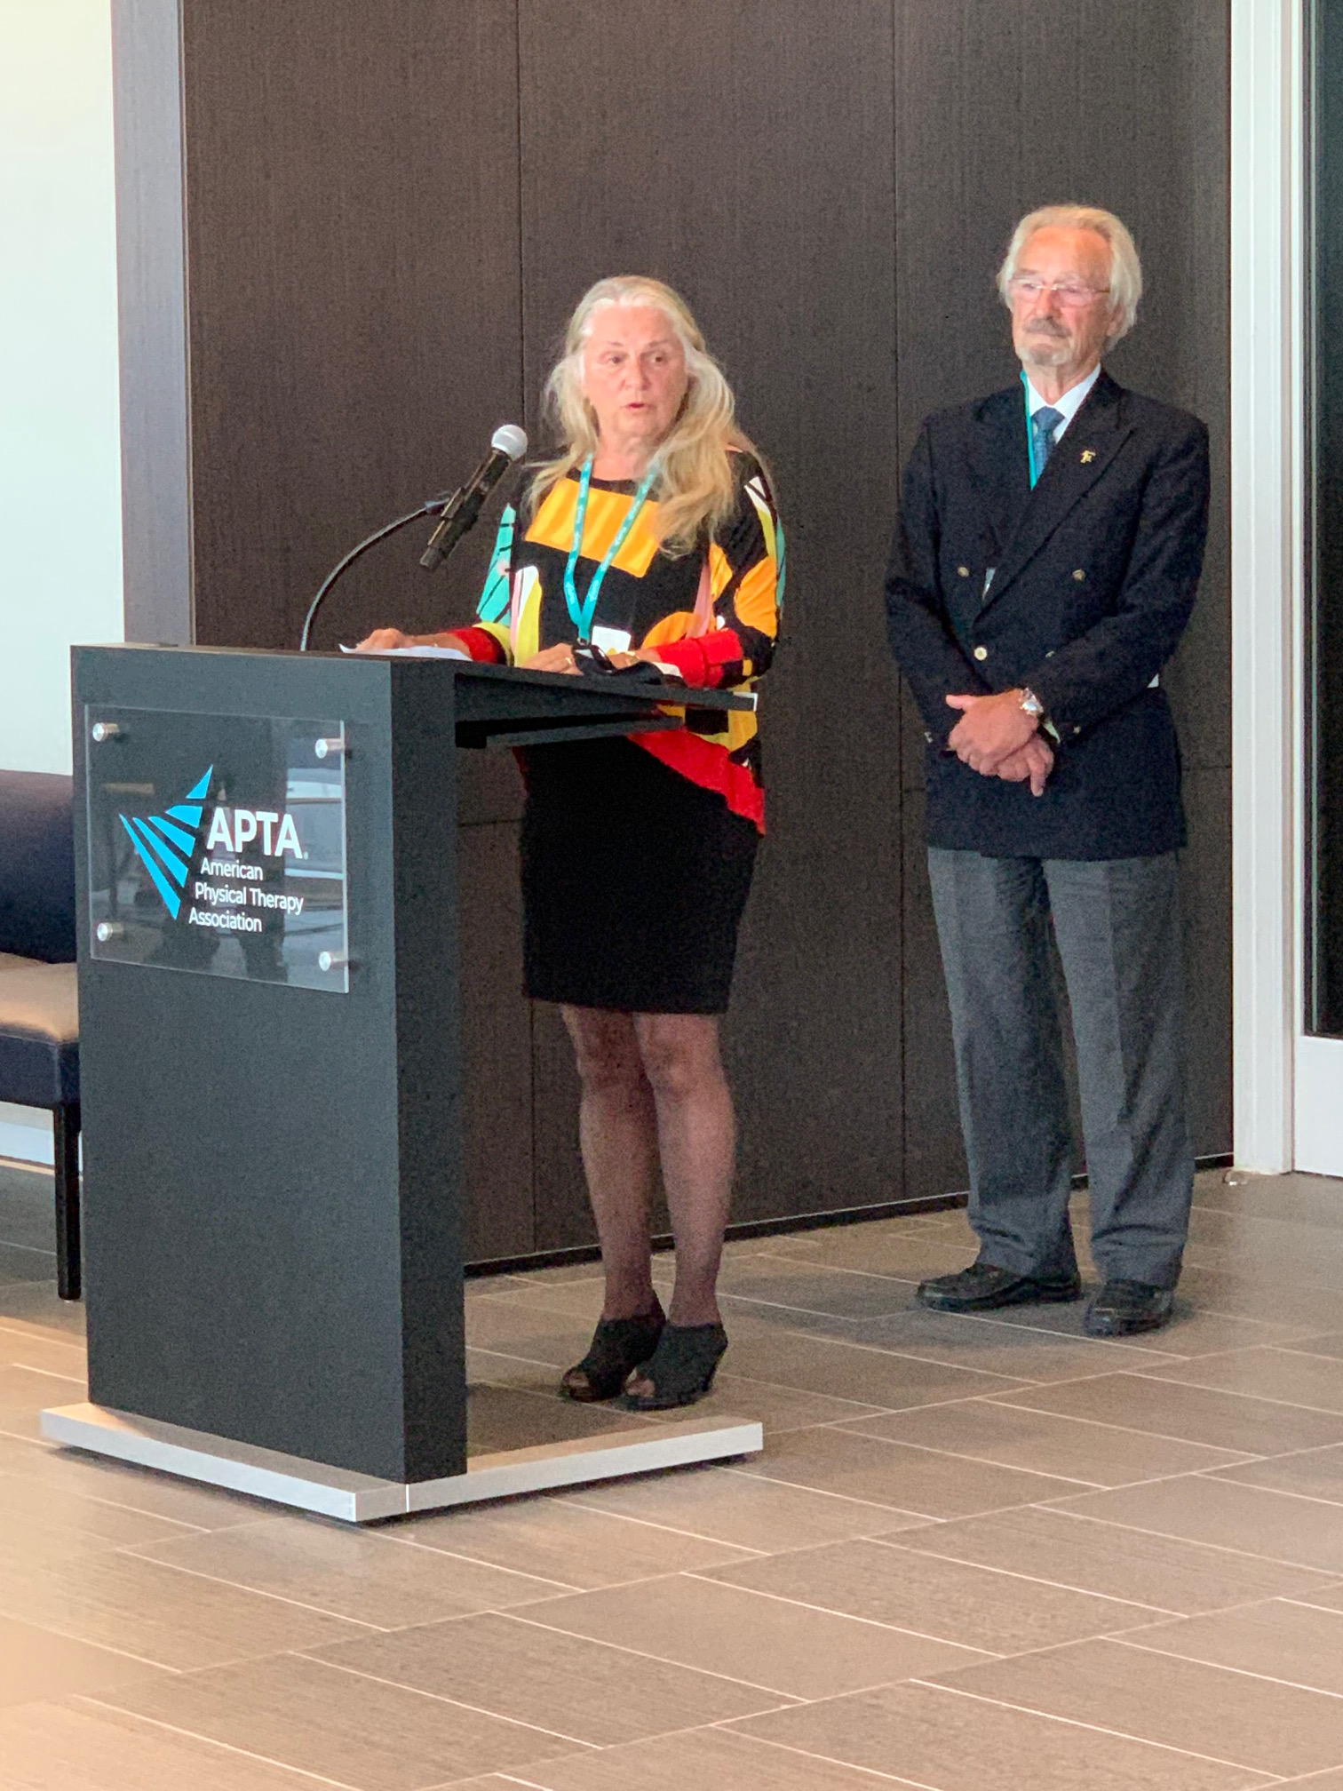
APTA Centennial Center Open House
Notes:
While ee didn’t get to host our “PT is Universal” party at Universal Studios in Florida, we did finally get to celebrate IN PERSON in September at APTA.
We kicked off the special weekend with an Open House at APTA Centennial Center just 2 weeks ago.
PICS—building, Room dedications: Marilyn Moffat Atrium and Move Art installation; Black PT Heritage Room honoring Leon Anderson Jr and Lynda Woodruff (AAPT gift); Stanly Paris and Catherine Patla Conference center; And 3 of our OPTA delegates on the 7th floor. What a view!

Slide 27

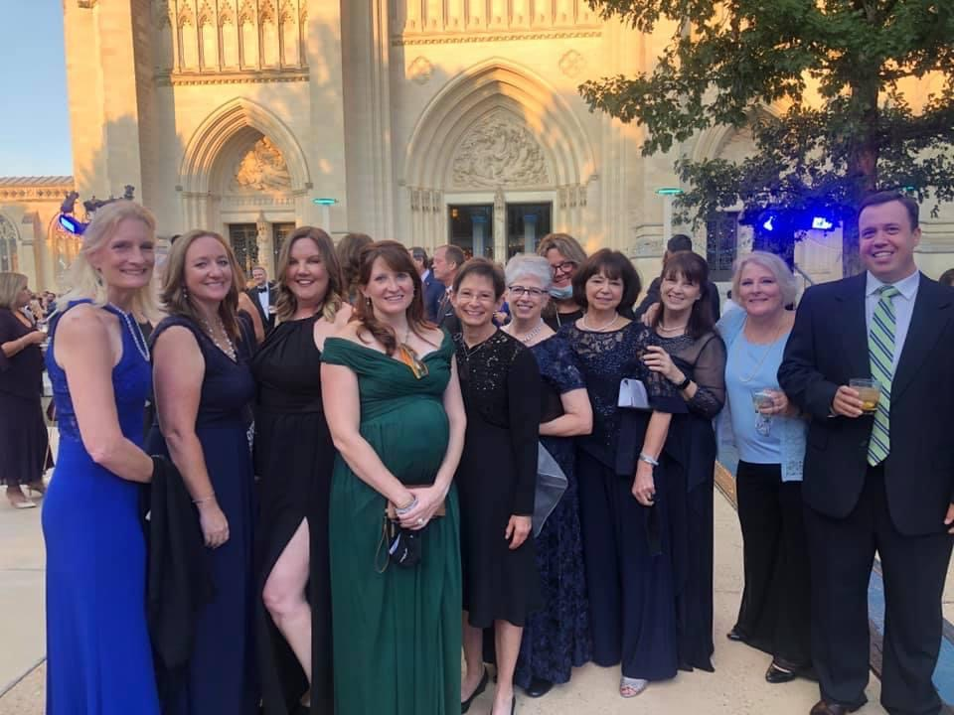

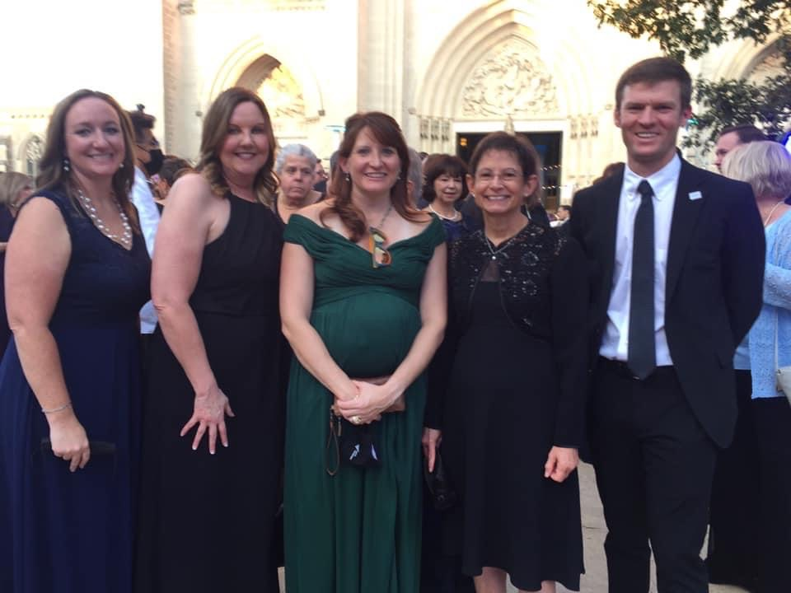
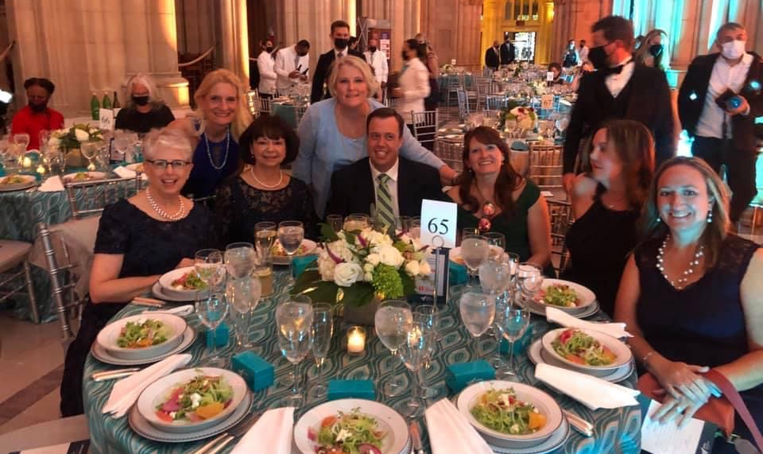
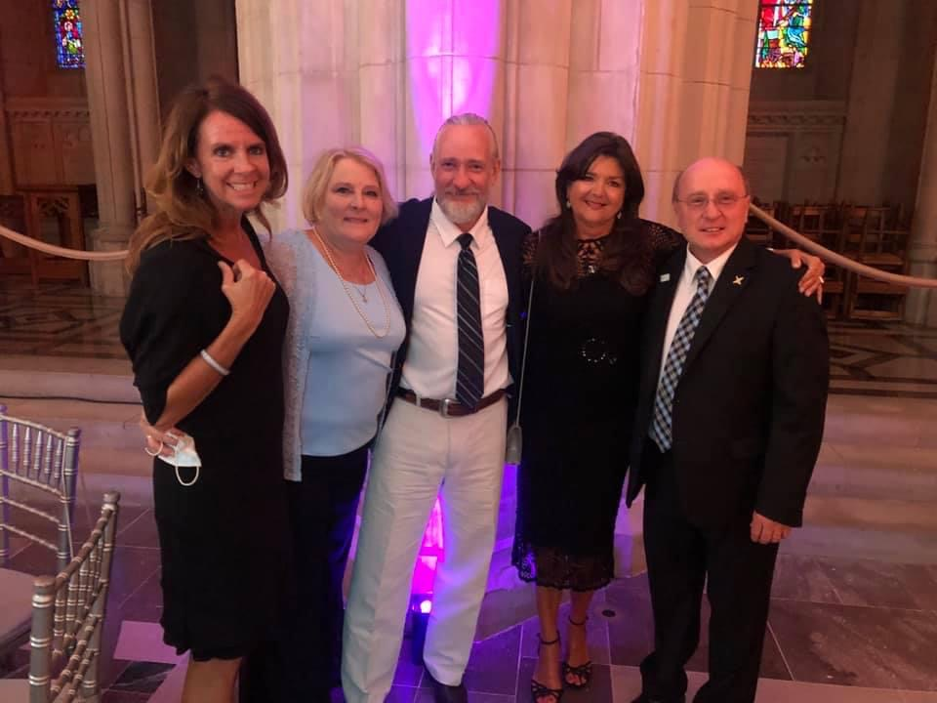

Notes:
That evening, we truly celebrated our 100th birthday with the centennial Gala hosted at the National Cathedral. It was a glorious evening. I’m sure you see some familiar faces here!

Slide 28
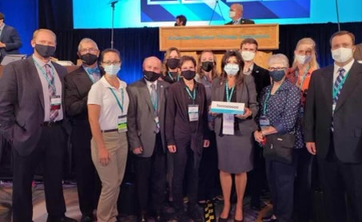
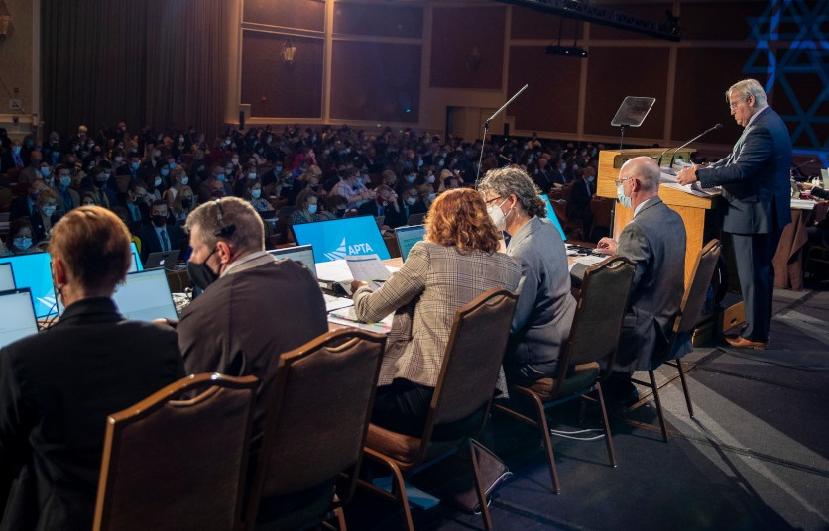
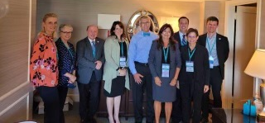
2021 APTA House of Delegates: September 11-12
Commitment to anti-racism, adding inclusion among our core values.
Commitment to making a positive impact through our national conferences and events.
Revision of our bylaws to – among other things – give PTAs voting representation within the House.
Address unethical productivity standards.
Promote the role of physical therapist services in recovery from COVID-19.

Slide 29
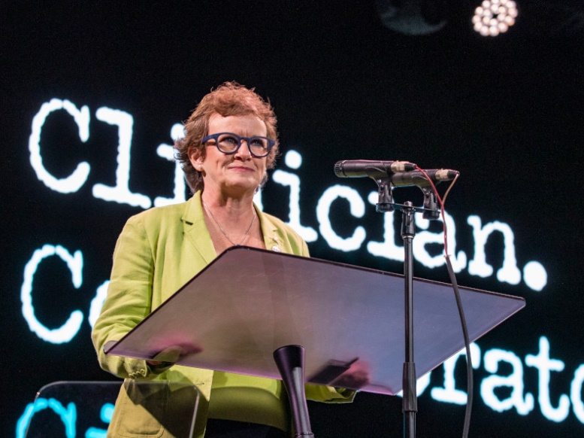
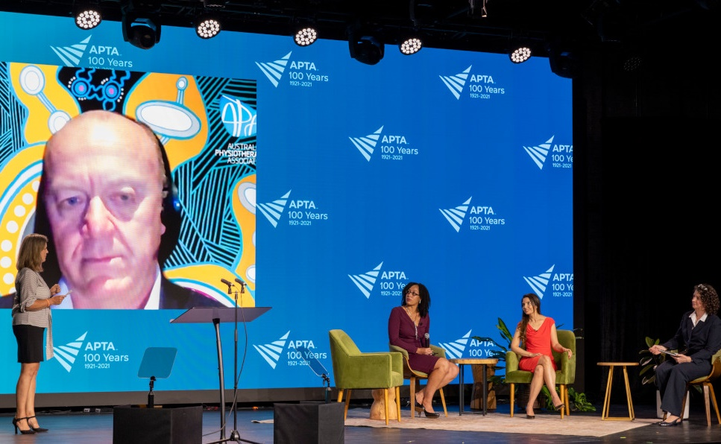

APTA Future of Physical Therapy Summit

Slide 30

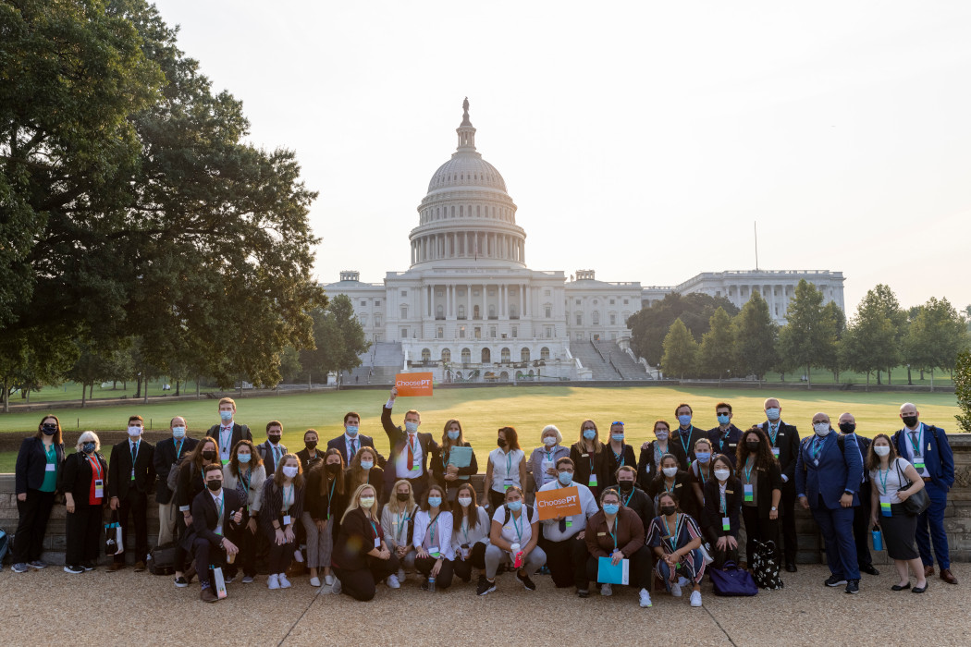
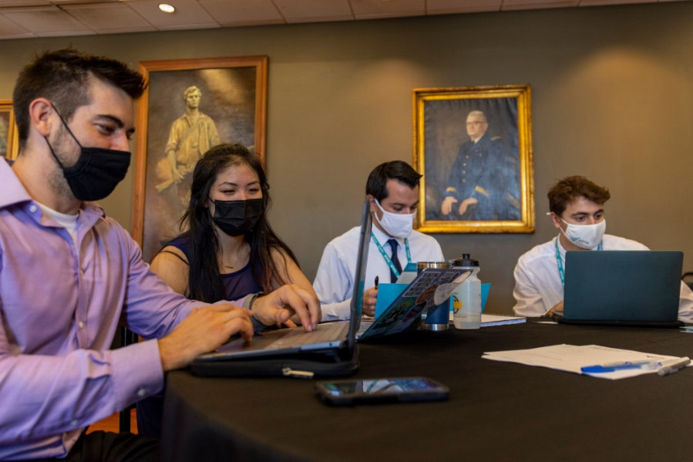
APTA Advocacy Day: September 13

Slide 31

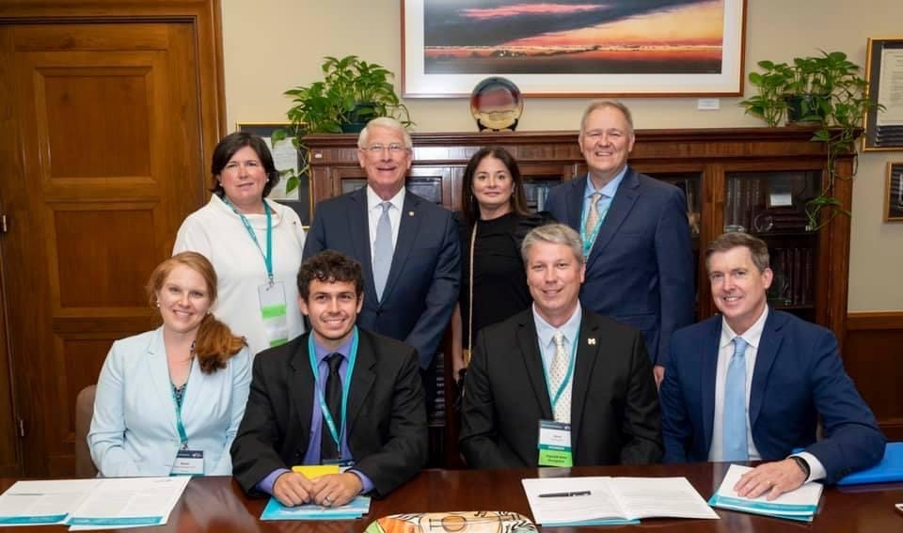
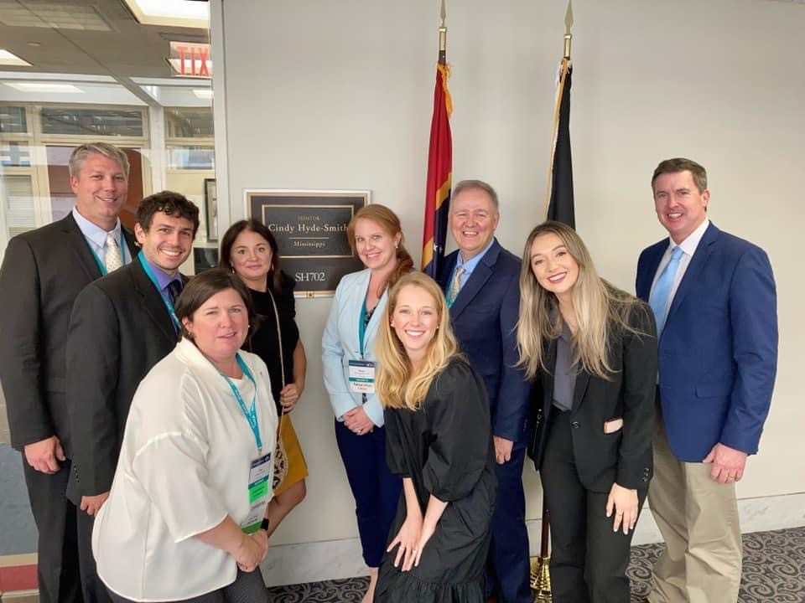
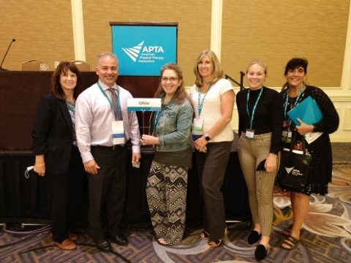
Notes:
And the last day of the centennial related events was Advocacy Day. We were the first major group advocating on Capitol Hill since the pandemic. While many of our visits were on Zoom, Anthony Di Filippo and Toni Doty did get to meet with a congressman on the Hill.
While this brought the centennial week festivities to an end, the centennial celebration is not over!

Slide 32




100 Days of Service
STARTS September 22, 2021
October 9th PT Day of Service
APTA Partners
  Special Olympics
  Go Baby Go
  Move Together
Access resources for service partners at centennial.apta.org/home/serve
Notes:
So what’s next……Service is in the heart of all of us in physical therapy. So, this past Tuesday, September 22, we launched our 100 days of service—for the last 100 days of the year.
Nationally, APTA has partnered with Special Olympics, Go Baby Go, and Move Together (the folks who brought us PT Day of Service years ago). There are tool kits available at centennial.apta.org for partnering with each of these organizations during these next 100 days and beyond.
Let OPTA and APTA know what events you have planned for the 100 days of service. It’s easy to do at centennial.apta.org.
But that’s not all…….
October 9: PT Day of Service. APTA is a proud supporter of Move Together and the PT Day of Service initiative within APTA’s National Physical Therapy Month and our 100 Days of Service.

Slide 33
Other Centennial Activities Happening Now…

Slide 34
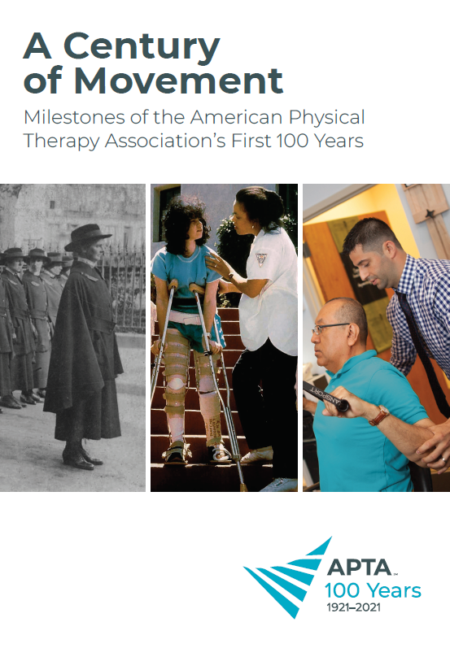
APTA Centennial Edition History Book
Highlights 100 milestones from our association’s first 100 years.
Available with other centennial gear at store.apta.org.
Net proceeds from centennial sales benefits APTA’s Campaign for Future Generations.

Slide 35

APTA Campaign for Future Generations
The campaign raises funds to support diversity, equity, and inclusion in our association and profession.
Donations can be made to the PT Fund, Minority Scholarship Fund, or Dimensions of Diversity Fund.
Search “Campaign for Future Generations” at apta.org to donate!

Slide 36
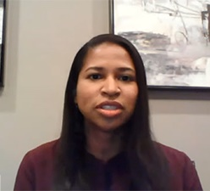
APTA Centennial Scholars Program
100 scholars sponsored by components, councils, and education programs.
Scholars are paired with mentors.
Scholars complete capstone projects on behalf of their sponsors.

Slide 37

APTA Centennial Lecture Series
Series includes:
“Practice Management: Balancing Compliance and Profit” by Lynn Steffes, PT, DPT.
“Blood Flow Restriction Rehabilitation: State of the Science” by Johnny Owens, PT, MPT.
“Physical Therapist Management of the Bicyclist” by Erik Moen, PT
Go to centennial.apta.org for the latest schedule.

Slide 38

APTA Centennial Gear
Visit store.apta.org

Slide 39
Small Group Discussion
How have you participated in events during our centennial year?
What is your biggest take-away from the centennial year so far?

Slide 40
Helping You Thrive

Slide 41

APTA 2021 – 2022 Public Policy Priorities
Goals of APTA's public policy goals are divided into four broad categories:
Patient access and care.
Population health and social determinants of health.
Value-based care and practice.
Research and clinical innovation.

Slide 42
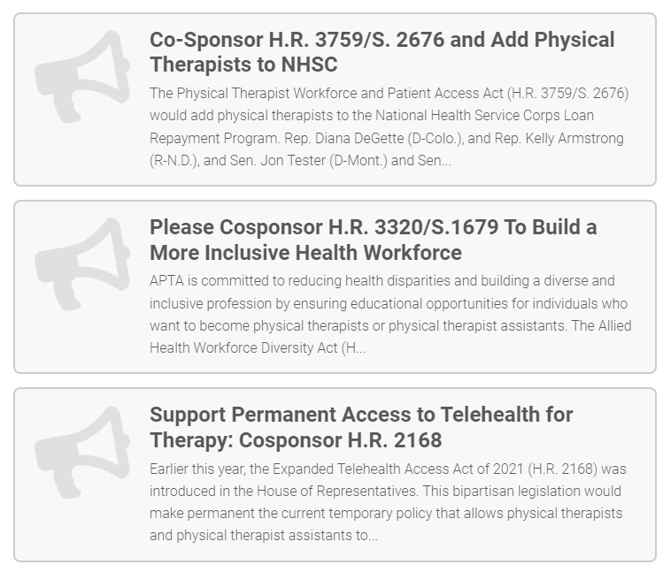
APTA-Backed Bills Introduced
2021 bills include:
Physical Therapist Workforce and Patient Access Act (H.R. 3759/S. 2676).
Allied Health Workforce Diversity Act
(H.R. 3320/S.1679)
Expanded Telehealth Access Act of 2021 (H.R. 2168)
NEW THIS WEEK:
Protecting Student Athletes from Concussions Act (H.R. 5216)
Primary Health Services Enhancement Act (H.R. 5365)
Visit APTA’s Legislative Action Center to contact Congress.
Notes:
Protecting Student Athletes from Concussions Act: Rep. Representatives Mark DeSaulnier (CA-11) and Pete Stauber (MN-08) have reintroduced the bipartisan Protecting Student Athletes from Concussions Act (H.R. 5216) in the 117th Congress. This APTA-supported bill would promote awareness of sports-related concussions in student athletes and develop comprehensive, evidencebased strategies to respond to these injuries. Sharon Dunn quoted in press release issued by Rep. DeSaulnier. • Primary Health Services Enhancement Act (H.R. 5365); Representative Kind (D-WI) introduced with original cosponsors Reps. Jackie Walorski (R-IN), Diana DeGette (D-CO), and Don Bacon (RNE). Rep. Ron Kind Introduces Bipartisan Bill to Expand Access to Physical Therapy Services in Rural Regions | Congressman Ron Kind (house.gov)

Slide 43

APTA Practice Advisory: Vaccine Administration
Our March practice advisory provided guidance to PTs and PTAs looking to get involved in COVID-19 vaccine administration.

Slide 44

APTA Practice Advisory: Information Blocking
On April 5, 2021, new regulations took effect to improve the sharing of electronic information with patients and between organizations.

Slide 45
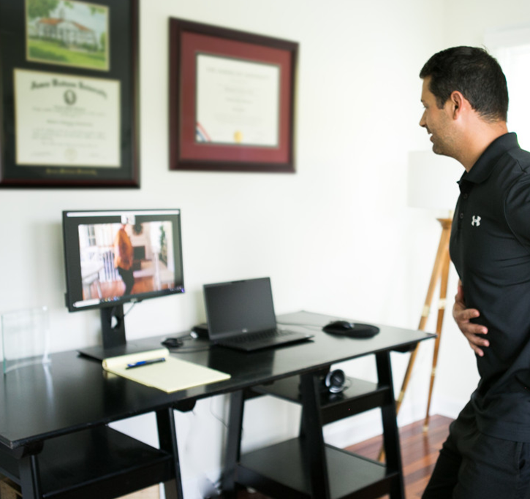
Telehealth Certificate Series
APTA has developed a telehealth certificate series to ensure that PTs, PTAs, and students are prepared to provide excellent care via telehealth.
Bulk purchasing options are available!
Go to the APTA Learning Center for more information.

Slide 46
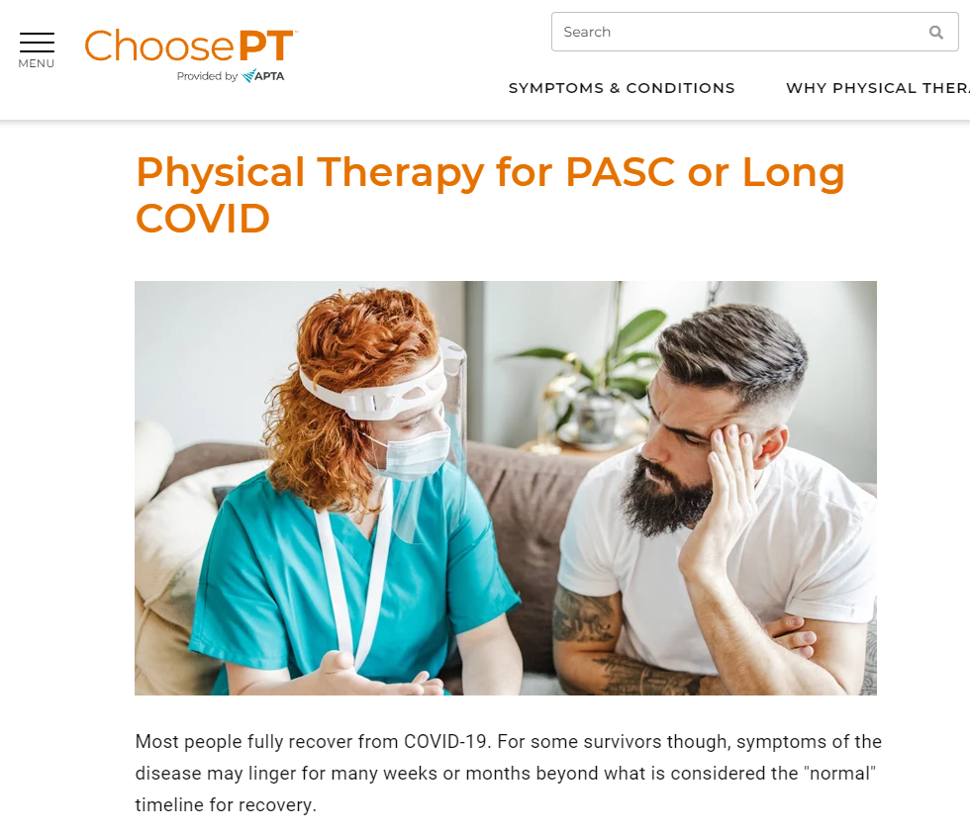
Raising Awareness
ChoosePT.com is accessed by millions of consumers each year, learning about the benefits of physical therapy.
Resources include:
Find a PT directory.
Symptoms and conditions guides.
Tips pages.
Podcasts and videos.

Slide 47
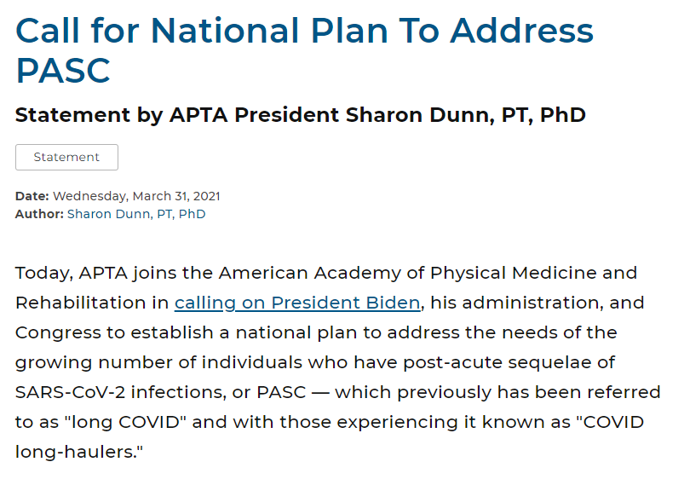
Call to Action on COVID-19
APTA joined the American Academy of Physical Medicine and Rehabilitation in calling for a national plan to address the needs of those with long COVID (PASC).

Slide 48
Small Group Discussion
What is you biggest concern for practice in the next 3-5 year?
How have you utilized resources from APTA, chapters and sections/academies in your practice?

Slide 49
What’s Next

Slide 50
APTA: What’s Next
“For all of my expectations, the greatest is that we will remember that we are in physical therapy to provide care to people. They deserve our best service, our respect, and our full attention. We must remember to engage our hearts with our heads and hands as we give service.”
Geneva R. Johnson, 20th Mary McMillan Lecturer
Notes:
Workplace for the future: New facility; Fitwell Certified level 3—highest and first in the DC area to achieve it
Workforce: PT, PTA, Educators, and importantly, APTA Staff
Advocacy efforts to move PT –better access for patients; payment systems that pay for value; new delivery models for care; new areas of practice, including further movement into first-contact providers
PT is not what we do, it is who we are

Slide 51


What’s Next?
Practice Environments
Telehealth
  Restrictions temporarily removed in response to pandemic
  Some insurers moving to permanently include PTs
Expansion of cash-based practices
Health Promotion, Prevention, and Wellness Opportunities
Consideration of Social Determinants of Health

Slide 52



What’s Next?
Our Community
Diversity, Equity, and Inclusion
New DEI standing committee
Advanced pipeline efforts
Board recommendations to CAPTE
Lynda D. Woodruff Lecture
Notes:
Why is diversity important for PT
Consider our clients/patients/ the society we serve.
We must be sensitive to cultural norms and diversity and be able to work with clients as we are.
Annual Woodruff Lecture established: Greg Hicks
Student Assembly BOD—very diverse
New DEI standing committee
Board recommendations to CAPTE
New APTA staff position
Advanced pipeline efforts
APTA hosted multiple virtual discussions on DEI

Slide 53


Slide 54

PT Moves Me
A student recruitment campaign and ambassador program from APTA designed to make it easier to reach the next generation of physical therapists and physical therapist assistants
Advisors, educators, or influencers play a key role in guiding prospective students to the physical therapy profession
APTA is recruiting PT Moves Me ambassadors for states and PT & PTA education programs
  Kudos to Belmont & Tennessee State ambassadors
Presentations prepared by APTA ready to go for a variety of audiences
  Late college
  High school/early college
  Middle & Elementary school (under development)
Potential to increase diversity in the applicant pool and profession
Notes:
What is physical therapy? Here is a formal definition, but, in short, physical therapy helps people move better. It helps improve movement and physical function to prevent and/or treat injury and chronic disease.
Big picture: Physical therapy is vital because it keeps people moving, and movement is one of the keys to life. Think about how your life would change if you couldn’t move or your mobility was limited in a way you are not used to.
Movement doesn’t refer just to running and dancing; we’re also talking about sitting and standing, walking, playing, bathing, breathing, even keeping lymph moving through your body. Physical therapists help keep people moving so they can live life to the fullest.

Slide 55

What’s Next?
Education
Education Leadership Partnership
  Strategic Framework for Professional & Postprofessional Physical Therapy Education
    Education Research
    Academic & Clinical Partnerships
    Competency Based Education & Entrustable Professional Activities
    Essential Resources
    Residency & fellowship Education

Slide 56



The Education Leadership Partnership: Purpose
The partnership is intended to be a group with a more global perspective than that of any one organization.
The voting members of the partnership should commit to pursuing the interests of the whole profession.
The partnership shall strive to bring together all relevant stakeholders having an interest in promoting excellence in physical therapist education. The [Partners] will solicit input and feedback from the organizations represented on
the [ELP] as well as other stakeholders.
ELP MOU, 2016
Notes:
As a result, in 2015 President Dunn and some members of the board met with leadership from the Academy of Education and ACAPT to discuss opportunities to move the education steering committee concept forward. That and subsequent discussions led to the development of a memorandum of understanding in 2016 that was signed by the presidents of the founding partners of the steering committee: President Dunn on behalf of APTA; Gina Musolino representing the Academy; and Barb Sanders representing ACAPT.
As stated in the MOU, the partnership is intended to be a group with a more global perspective than that of any one organization, that is committed to pursuing the interests of the whole profession, and strives to bring together all relevant stakeholders having an interest in promoting excellence in PT education.
As guided by the MOU, the initial work of the partnership focused on the recommendations of the Excellence in Physical Therapist Education Task Force and the added recommendation that PTA education issues be considered.

Slide 57
Background: Information that Informed this ELP Effort
2021 - Present
2015
Excellence in PT Education Task Force
2016
Work of the Education Leadership Partnership
2017
Best Practices in PT Clinical Education Task Force
2017
National Study on Excellence and Innovation in PTE
2018
Education Leadership Partnership added scope and vision
Historical Context

Slide 58


Slide 59
Outcome Competencies -Graduates
Model/Pathway of Education
Standardized Performance-based Assessments - Students
Standardization
PTA Education Issues
Data Management System
Data Management System
Collaborative Vision for the Future of PT Education
Cost of Education/Student Debt
Research Agenda
Research Agenda
DEI Issues in Education
Faculty Development
Academic-Clinic Partnerships
Essential Resources

Slide 60

Consideration for Clinical Education
Clinical
Education

Slide 61
Examples of Work Resulting from Strategy Group Recommendations
Education Research:
Education Data Catalog
Grant Writing and Mentoring in Education Research (GAMER) workshops
Medical Education Research Certification (MERC) program
Education Research Network
Competency-based Education:
Series of developmental presentations
Working panels: Domains of competence; entrustable professional activities; research
Stakeholder reactor panel
Residency Competency Instrument
Notes:
This slide provides some examples of the work initiated by the partnership as a result of strategy group recommendations and prioritization. More information about these partnership initiatives is available in the 2021 CSM presentation linked in the references and resources page that accompanies this presentation.

Slide 62



National Study on Excellence and Innovation in Physical Therapist Education

Slide 63
Education Strategy Group Sessions
Project Element | Timing
Education Research Strategy Meeting | January 2017
Clinical Education Strategy Meeting | October 2018
Outcomes Strategy Meeting | April 2019
Essential Resources Strategy Meeting | September 2019
Academic-Clinical Partnerships Strategy Meeting | March 2020
Closing/Culminating Strategy Process | July 2020 / May 2021

Slide 64
Closing/Culminating Strategy Process (2020-2021)
Project Element (McKinley Advisors) | Timing
Immersion and Planning | October 2020
Review Background Materials and Past Research | October 2020
Virtual Strategic Planning Sessions with the ELP | October to November 2020
Draft “Straw Model” Framework | December 2020
Electronic Survey with Stakeholder Community | December 2020 to January 2021
Refine, Finalize and Present Strategic Framework | January to February 2021
Submit Report to APTA BoD | August 2021

Slide 65
Stakeholder Feedback Process
Education Stakeholder Survey:
  1,301 respondents
  Project overview
  Quantitative and qualitative data
Town Hall:
  286 participants
  Project overview
  Preliminary survey findings
  Q&A session

Slide 66
Six Major Themes (Pillars) Identified
Accessibility of Education
Collaboration and Networks
Competency-Based Education
Diversity, Equity and Inclusion
Education Research and Data Management
Infrastructure, Capacity, and Faculty Development

Slide 67

The Work Ahead: Leveraging Collaboration Among All Education Stakeholders to Achieve the Vision
Will be publically available later this month

Slide 68
Small Group Discussion
What concerns do you have relative to PT and PTA education?
What changes do you think need to be made in education to prepare graduates for practice in the future?

Slide 69
Notes:
The recent centennial events have certainly highlighted the importance of community. We were all so excited to be together for all of the events. In total, we had over 1500 people participate in some part of the week. Ohio was well represented all week long!
So I leave you with our mission:
Building a community that advances the profession of physical therapy to improve the health of society.

Slide 70
Thank You

